Slide 1
Intro to BlissymboliCs
Using a Language to Teach Communication
Notes:
If you think it’s best to teach children to communicate by using a language instead of a collection of arbitrary images or shapes, I’d like to tell you about the language of Blissymbolics.

Slide 2
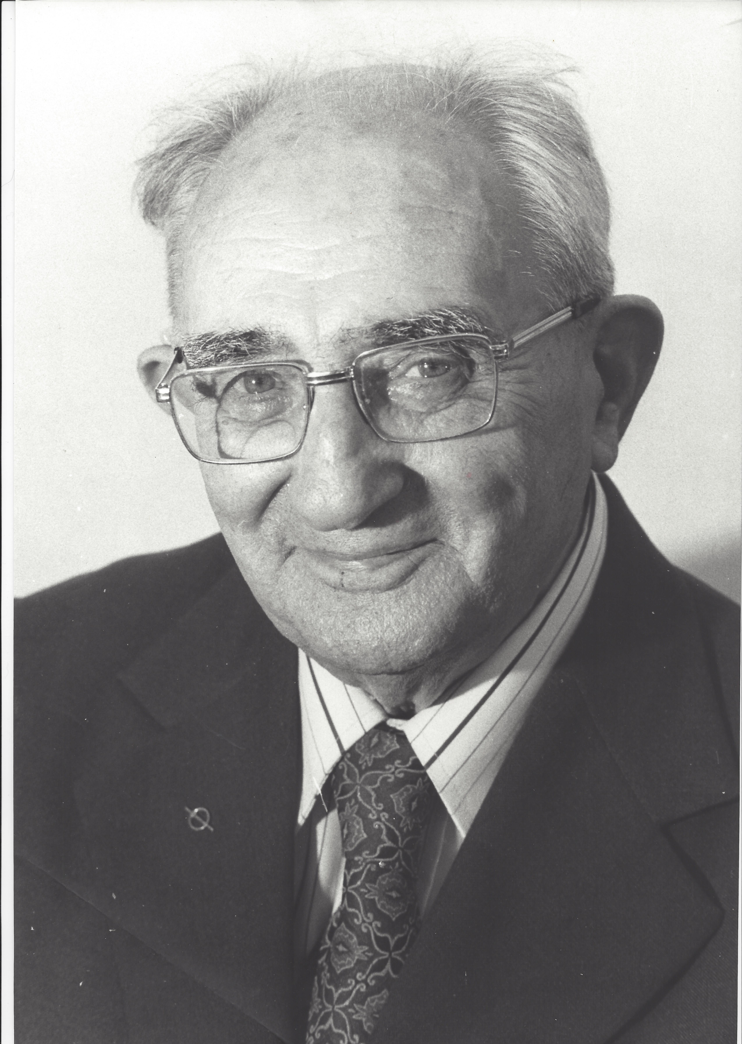
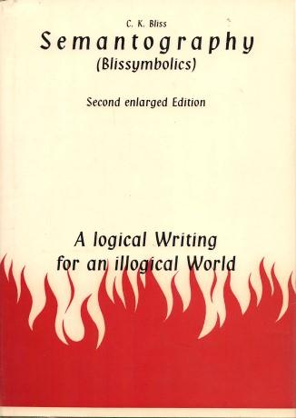
What are Blissymbols?
Blissymbols, originally created by Charles Bliss in 1947, is a constructed, ideographic, generative language.
Each Blissymbol represents a concept rather than a word. So, they can be used by people from different cultures and with different spoken and written languages.
Notes:
Blissymbols were developed by Charles Bliss in the 1940s. He was looking for a language that could be learned and used by anyone on earth.
His language is:
constructed – consciously devised instead of naturally evolved
ideographic – graphic symbols that represent an idea or concept, without phonology
generative – able to create an infinite number of concepts from an initial finite set
The language is purely conceptual. The symbols don’t have to be translated into a spoken language in order to be understood. This has special implications for cognitively disabled individuals.

Slide 3

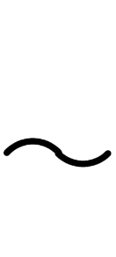
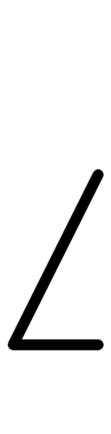

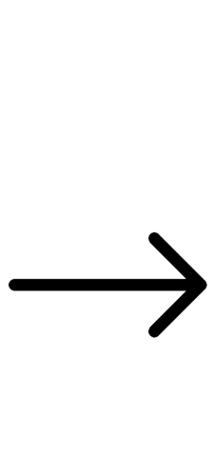

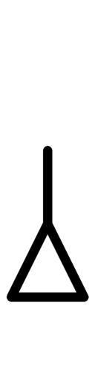
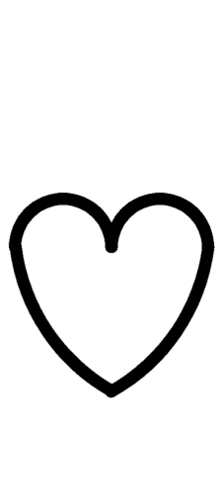



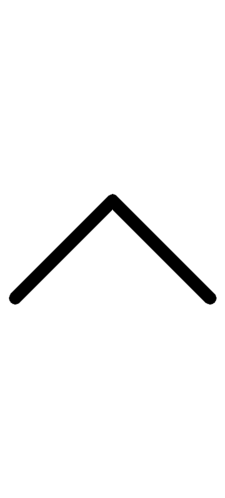
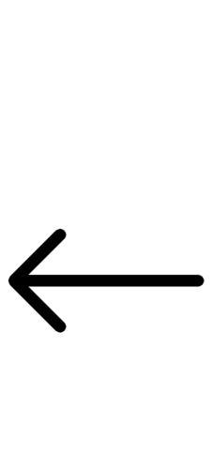
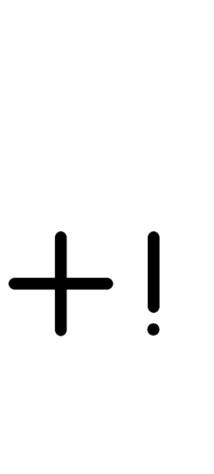


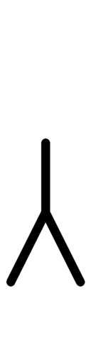

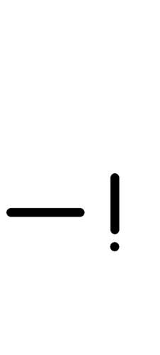
What do basic Blissymbols look like?
Notes:
Blissymbols are constructed using a few straight lines and simple curves. As such, they require less cognitive effort to explore and recognize. For tactile learners, this means that the symbols can be processed more quickly and reliably than symbol sets that are more complex in their construction.

Slide 4
What do these strange shapes mean?
forward | backward | upward | downward
positive | negative | feeling | protection
Notes:
Basic Blissymbols are pictographic in nature. Their associated concepts relate easily to their graphic. For example, the “roof” shaped symbol represents protection. More complex concepts build on these simpler concepts.

Slide 5
What do these strange shapes mean?
enclosure | container | man | woman
mouth | eye | nose | ear
Notes:
Additional simple shapes for simple concepts.

Slide 6
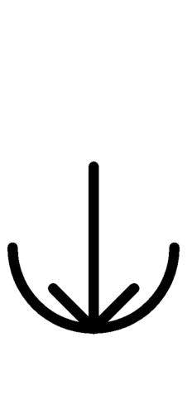
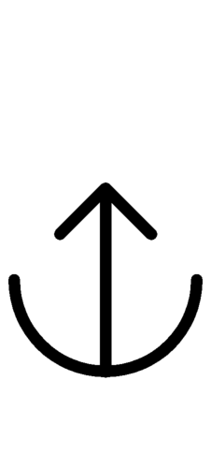
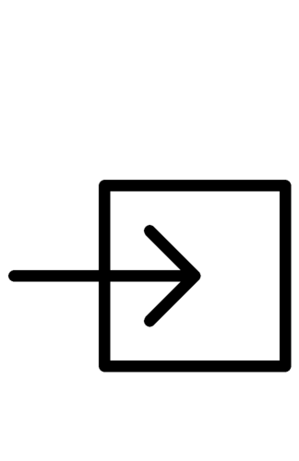
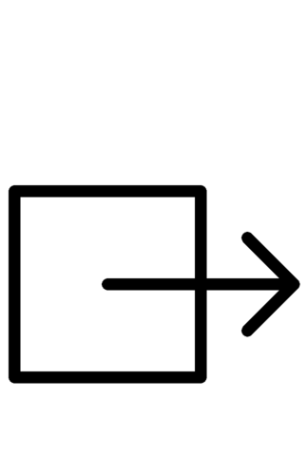
Building new concepts by superimposing basic concepts:
forward | upward | downward
enclosure | container
into | out of | get | give
Notes:
More complex concepts can be constructed from the simpler concepts by overlaying one on the other. Here we see the arrow concepts overlayed on the enclosure and container concepts to convey new concepts like into, out of, get, and give.

Slide 7
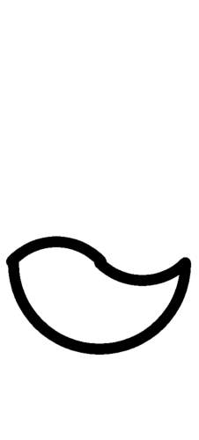
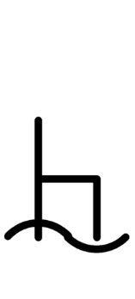
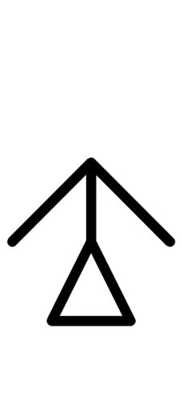
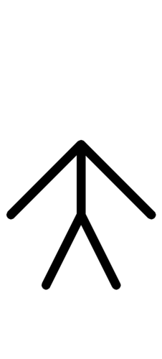
Building new concepts by superimposing basic concepts:
woman | man | container | chair
protection | water
mother | father | bath | toilet
Notes:
A female protector is a “mother”. A similar and consistent process is used for “father”. A container with water is a bath. A chair over water is a toilet.

Slide 8
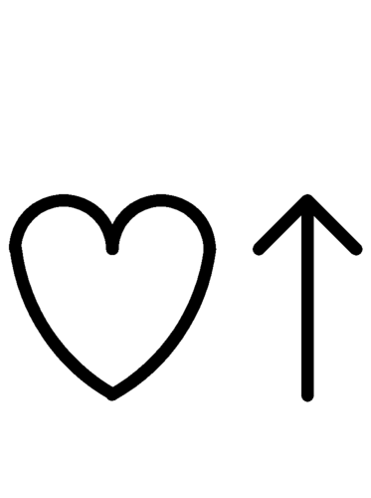
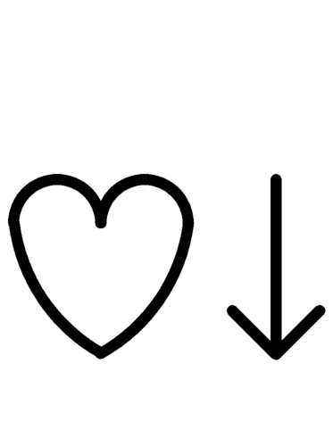
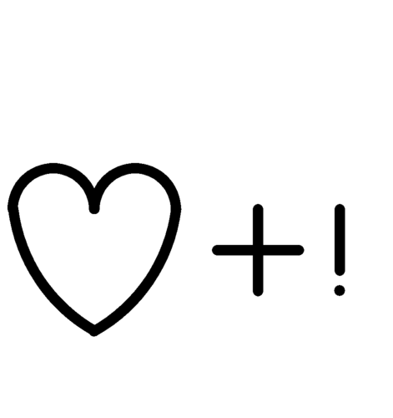
Building new concepts by stringing symbols together:
upward | downward | positive | negative
feeling
happy | sad | good | bad
.
Notes:
Concepts may also be created by appending one basic symbol to another. For example, all “feeling” words in Blissymbolics have the heart shape at their core. They are then qualified by appending other shapes to represent specific feelings. Feeling “up” means happy, while feeling “down” means sad. Positive feelings mean being good, while negative feelings mean being bad.

Slide 9
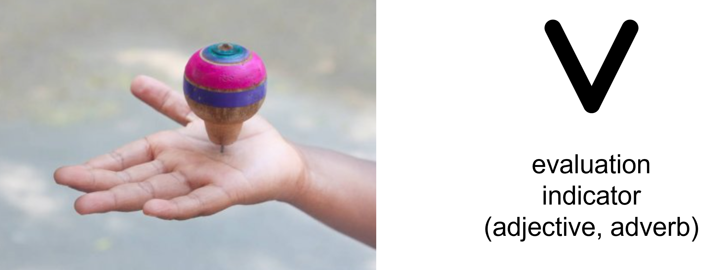
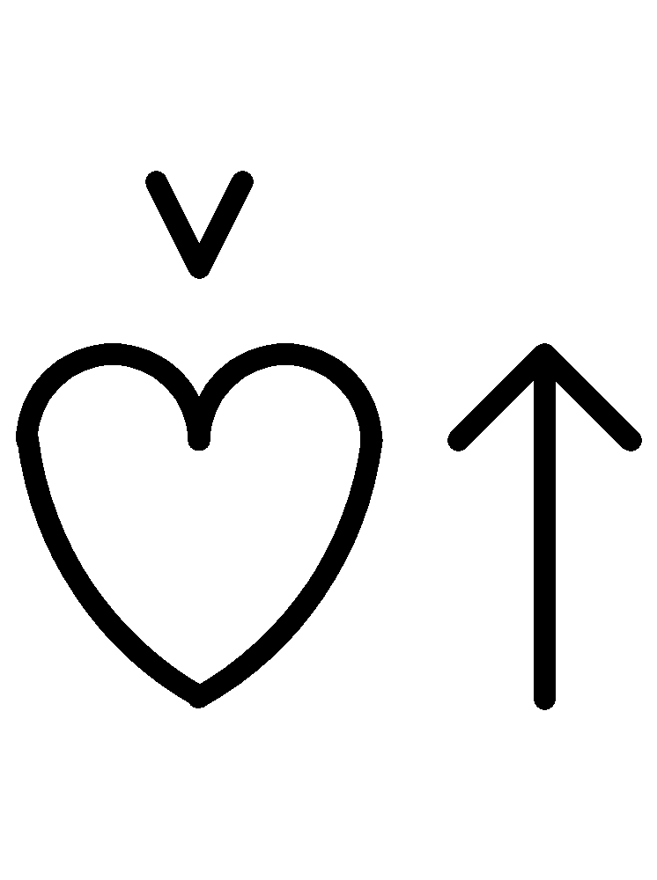
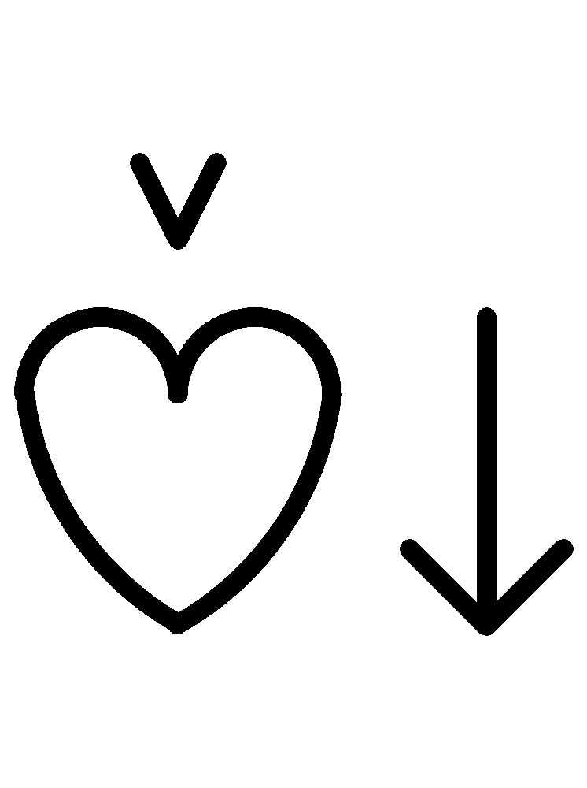
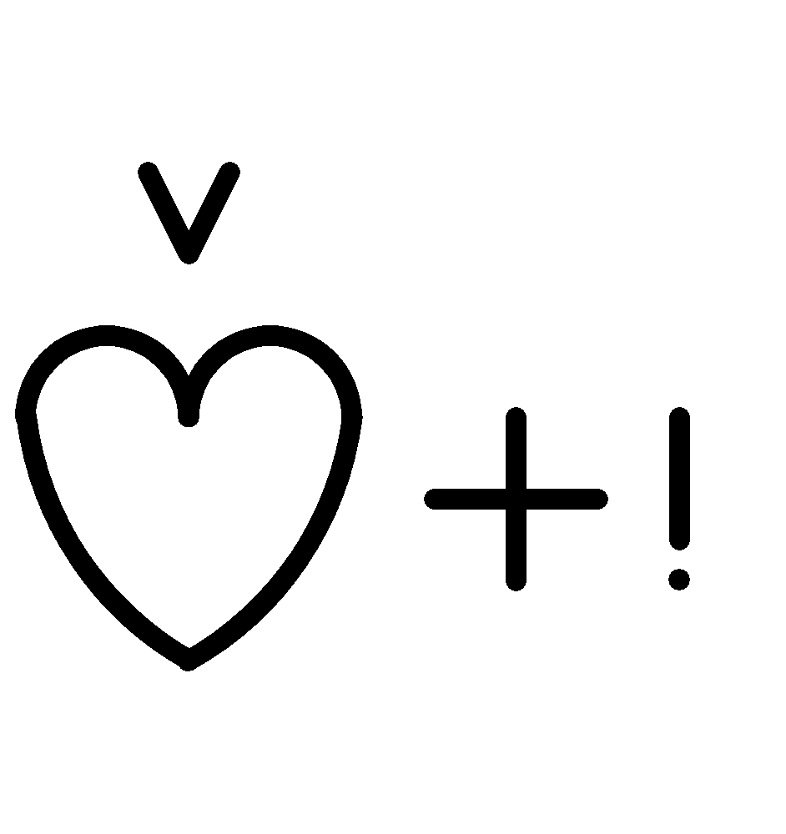
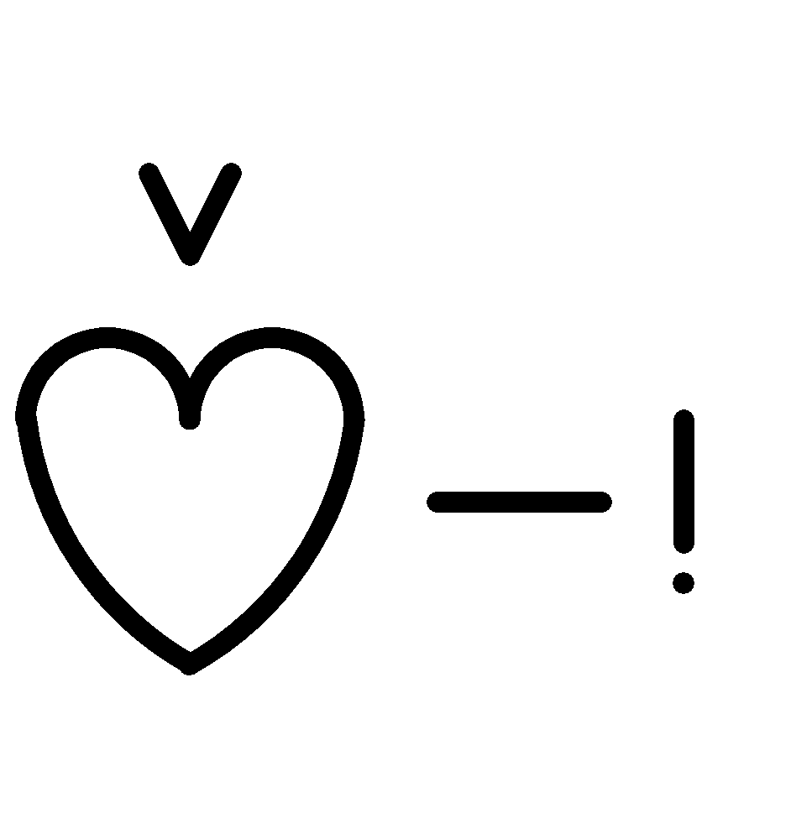
Adjectives/adverbs: That’s just your opinion!
happy
sad
good
bad
.
Notes:
Charles Bliss survived the concentration camps of World War II and was deeply affected by Nazi propaganda. When he created his new language, he wanted the language to clearly indicate when a concept was fundamentally an opinion rather than a fact. An adjective or adverb could lean either way depending on your point of view. He put an “unstable”, angled shape over these concepts.

Slide 10
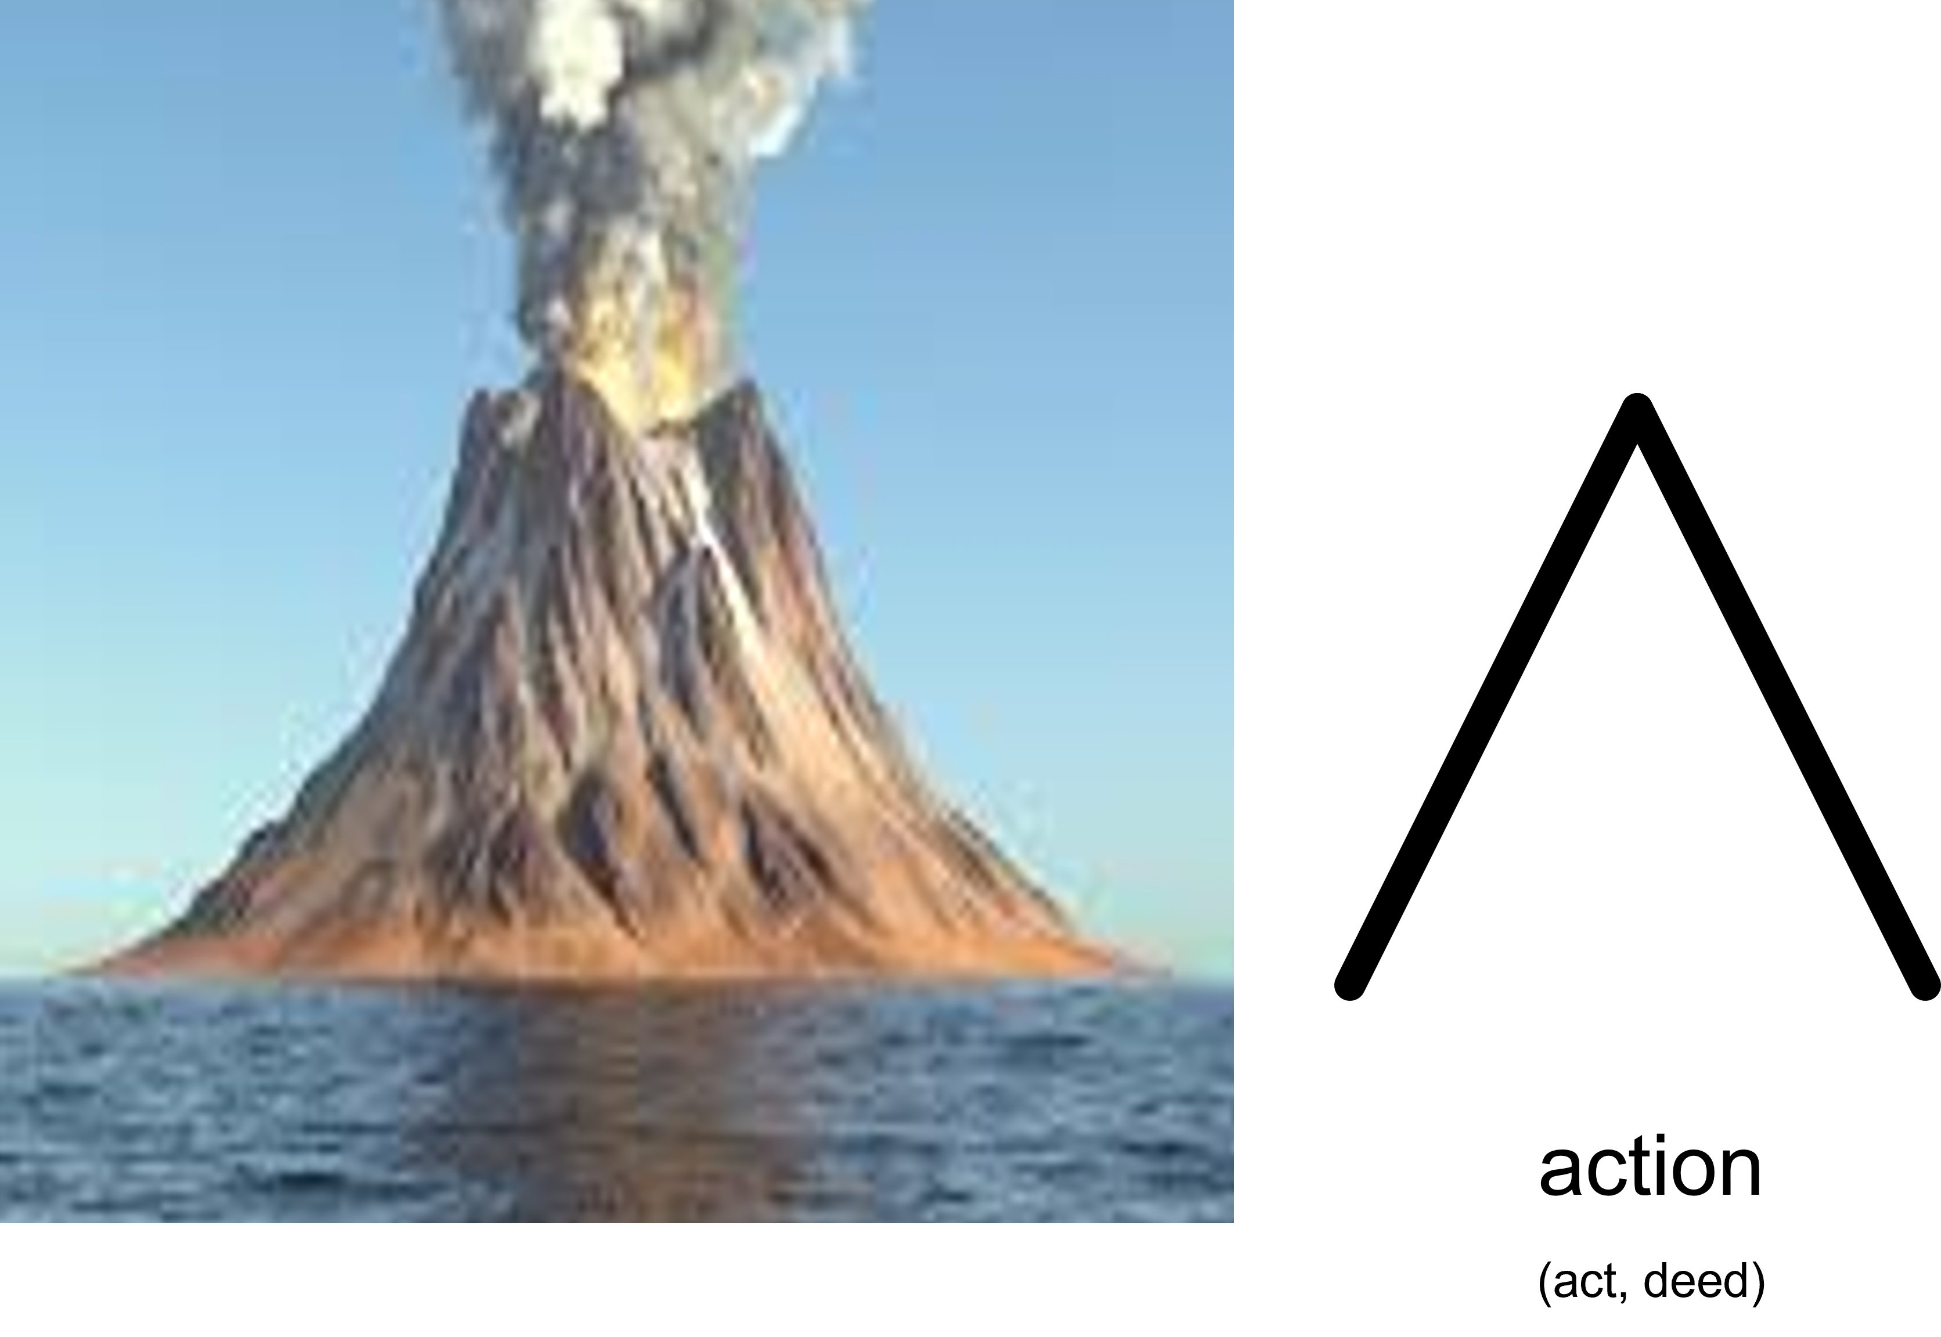
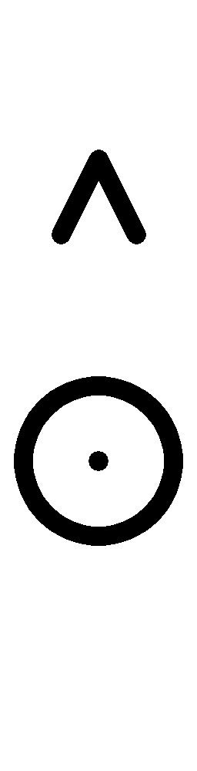
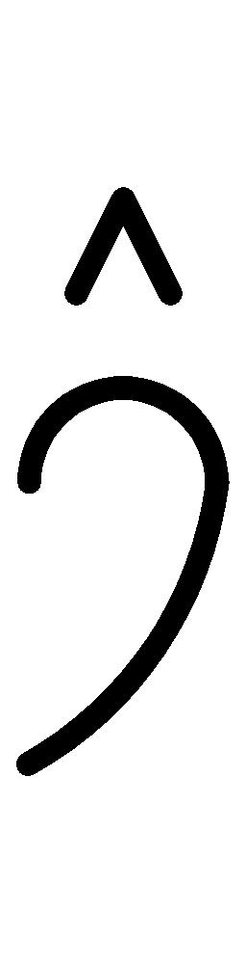
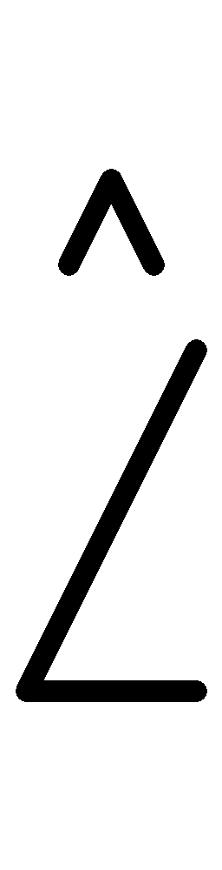
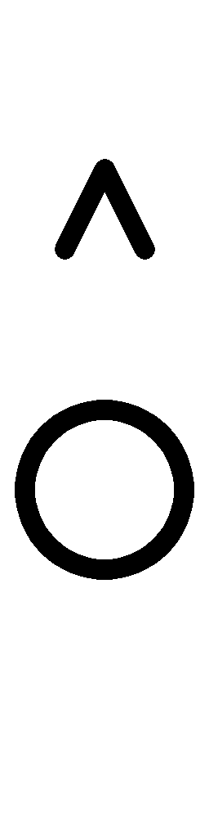
Nouns to Verbs: the “action” indicator
eye | ear | nose | mouth
to see | to hear | to smell | to speak
Notes:
For Bliss, a volcano epitomized action and power, so he drew his action indicator from the shape of a volcano. He asked, “what does the eye do?” – it sees. “What does the ear do”? – it hears. And so on. This is how verbs are easily built from nouns.

Slide 11
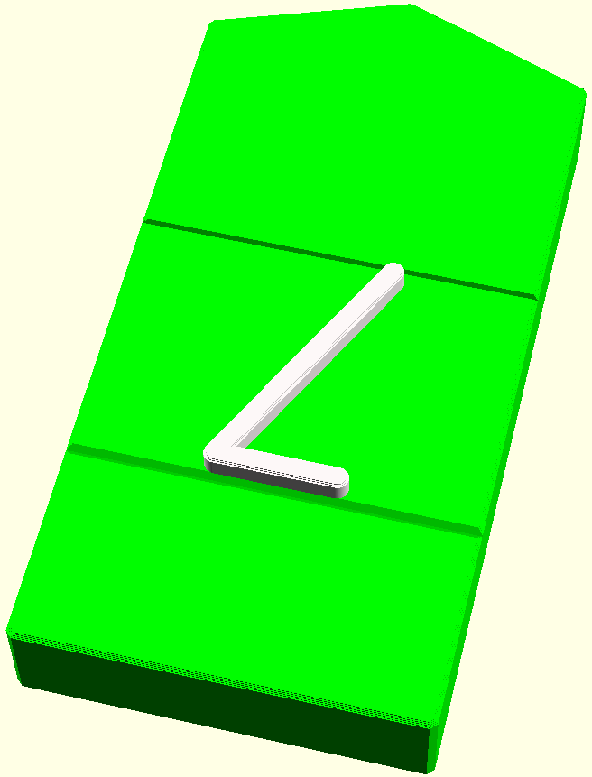
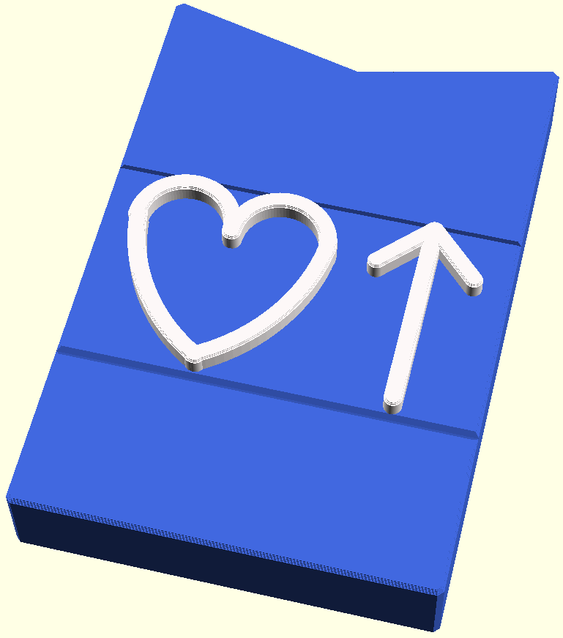
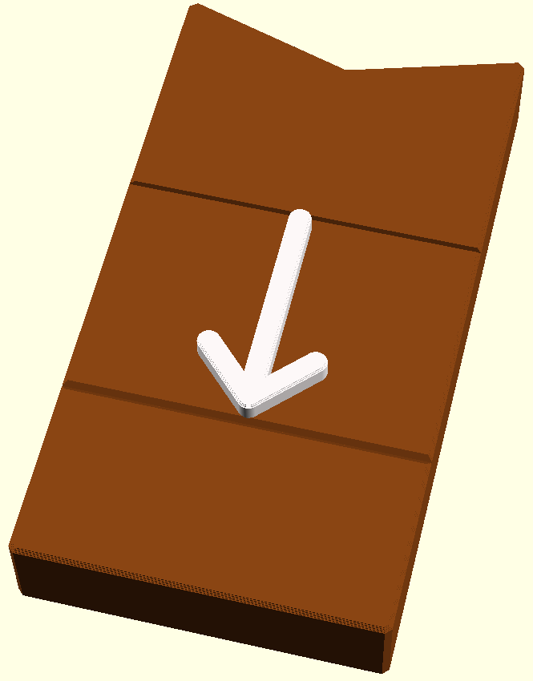
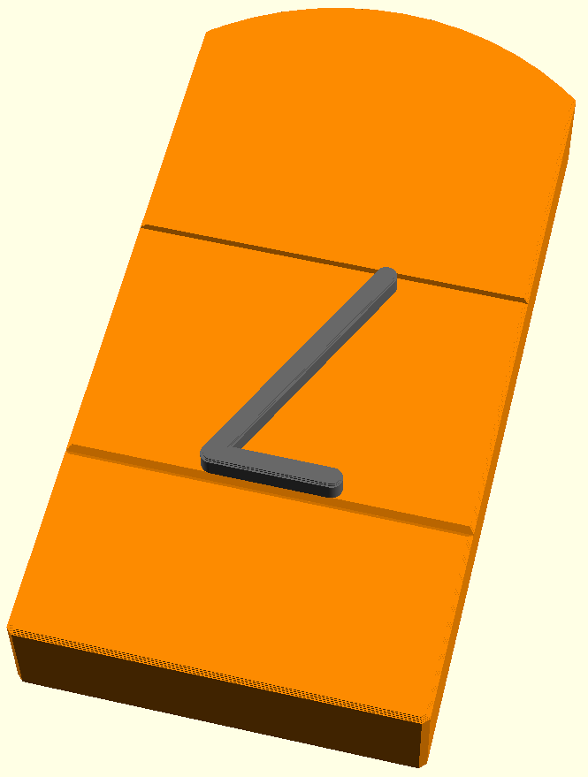
Bliss Tactile Symbols
smell
(verb)
happy
(adjective)
down
(adverb)
nose
(noun)
Notes:
Our 3D-printed, Bliss Tactile Symbols reflect the two types of indicators in the tope edge of the symbol. Verbs have an “action indicator” like top. Adjectives and adverbs have an evaluation indicator like top edge. Nouns have a rounded top edge, instead. In addition, you can use filament color to distinguish among the parts of speech. In this case, we’ve used colors from the Fitzgerald Key.

Slide 12
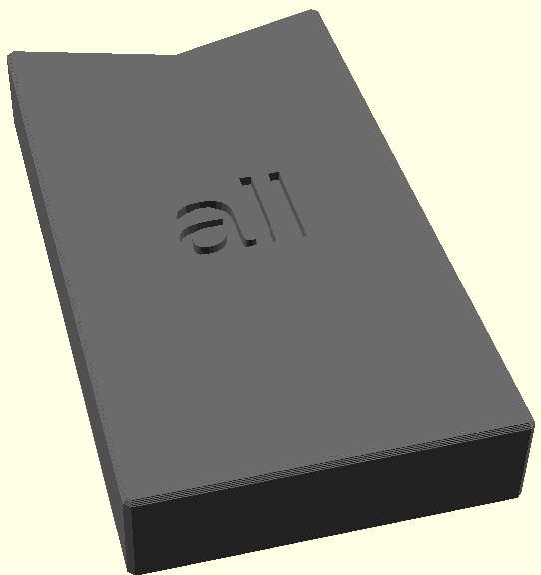
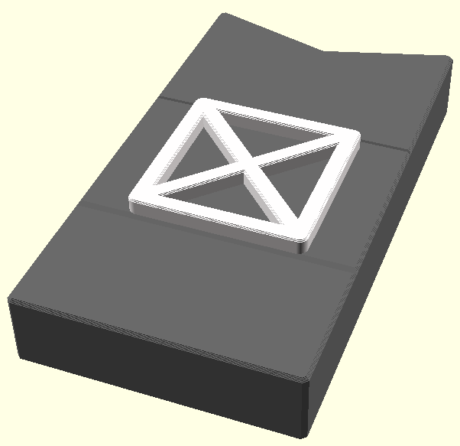
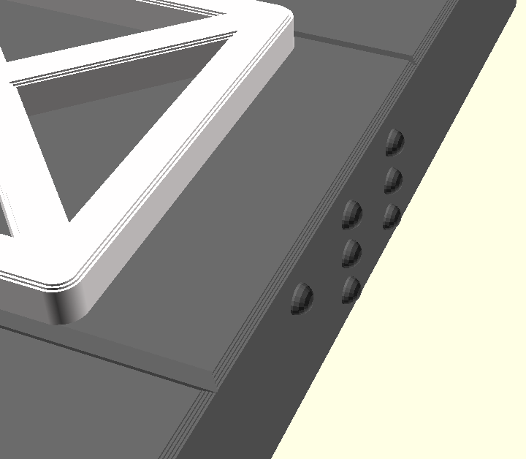
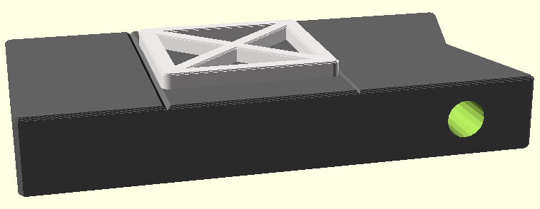
Enhancing Bliss Tactile Symbols
engraved text on back
Braille on side
hole for string
all
(determiner)
Notes:
These symbols can be enhanced by placing engraved text on the back surface, adding Braille to the sides, or including holes at different locations for mounting the symbol on a string.

Slide 13
To learn more about Blissymbolics…
Intro to Blissymbols
Blissymbolics Communication International
The Structure of Blissymbolics, Workshop
LA Blistric – YouTube
(Book) Teaching and Using Blissymbolics
(Book) Handbook of Blissymbolics
Notes:
You can learn more about the possibilities of representing concepts through Blissymbols by visiting these web sites and pages.

