Slide 1
1

Slide 2
after
again
aide
all
and
answer
arm
baby
because
before
big
body

Slide 3
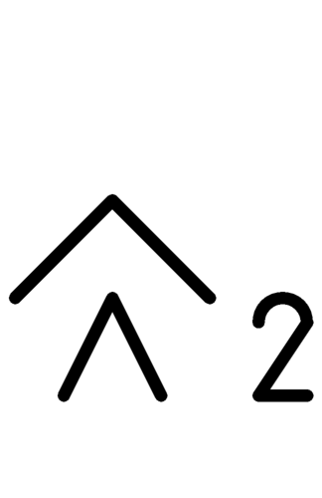
bottom
boy
brother
bus
child
children
day
ear
evening
eye
face
family

Slide 4
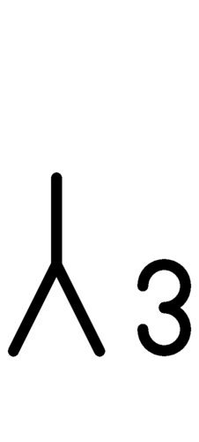
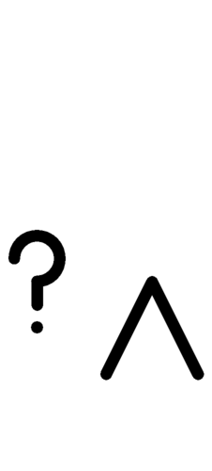
father
food
girl
hand
he, him
head
how
how much
I, me
idea
in
it

Slide 5
legs and feet
man
mother
mouth
name
night
no
nose
not, don’t
off
on
one

Slide 6
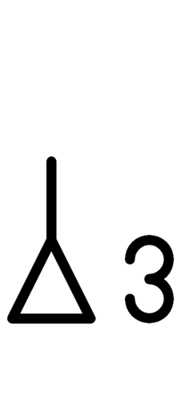
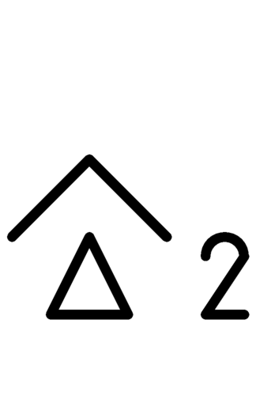
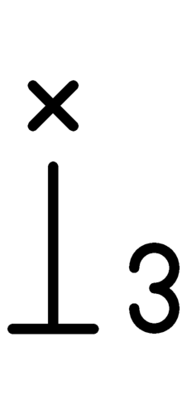
or
out
over
people
place
please
question
she, her
sister
ten
that
they

Slide 7
thing
this
time
top
under
we
what thing
where
who
why
woman
yes

Slide 8
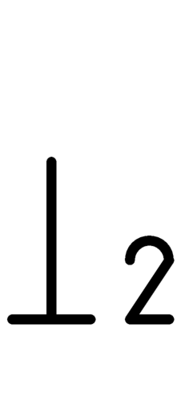
you
xx
xx
xx
xx
xx
xx
xx
xx
xx
xx
xx

Slide 9
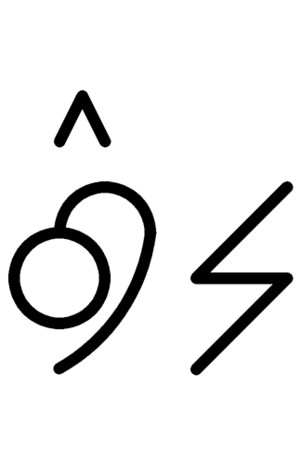
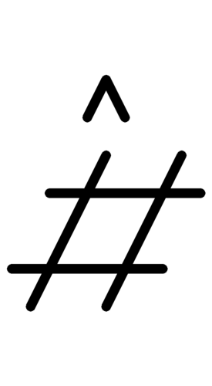
ask
after
buy
call
can
close
come
count
die
do, does
dress
drink

Slide 10
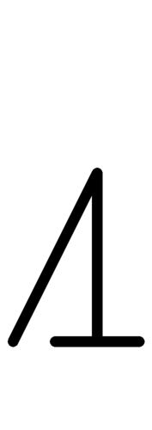
drive
eat
feel
get
give
get
have, has
hear, listen
help
hold
is, are
know

Slide 11
let
live
long
make
need
open
put
read
ride
say, tell
see, look
sell

Slide 12
sing
sit
sleep
smell
stand
stop
take
taste
think
touch
turn
walk

Slide 13
was, were
wash
watch
work
write
xx
xx
xx
xx
xx
xx
xx

Slide 14
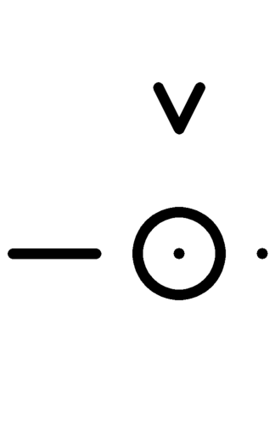
ask
busy
clean
different
down
dry
easy
eight
fast
favorite
five
four

Slide 15
full
here
hot
little
loud
maybe
more
most
much, many
new
nine
none

Slide 16
now
right
same
seven
short
sick
six
smart
some
there
three
two

Slide 17
up
wet
wrong
xx
xx
xx
xx
xx
xx
xx
xx
xx

Slide 18
1.25

Slide 19
stuff
today
tomorrow
tonight
what
when
yesterday
xx
xx
xx

Slide 20
find
grandfather
grandmother
share
want
color
xx
xx
xx
xx

Slide 21
cold
xx
dirty
empty
finished,
all done
happy, fun
hard
hers
his
love

Slide 22
quiet
ready
sad
soft
their
your
xx
xx
xx
xx

Slide 23
1.5

Slide 24
bus driver
home
morning
pet
problem
SLP
thank you
trouble

Slide 25
way
xx
xx
xx
xx
xx
xx
xx

Slide 26
hate
like
play
take a break
try
wait
wake up
xx

Slide 27
all gone
bad
dumb
good
hurt
late, later
mean
medium

Slide 28
my, mine
old
slow
tired
xx
xx
xx
xx

Slide 29
1.75

Slide 30
afternoon
friend
sorry
town
xx
xx

Slide 31
confused
hurry
win
xx
xx
xx

Slide 32
afraid
funny, silly
hungry
lose
nice
pretty

Slide 33
2

Slide 34
goodbye
hello
teacher
xx
xx
xx

Slide 35
xx
xx
xx
xx
xx
xx

Slide 36
mad
thirsty
xx
xx
xx
xx

Slide 37
2.25

Slide 38
pet’s name
school
xx
xx

Slide 39
xx
xx
xx
xx

Slide 40
xx
xx
xx
xx

Slide 41
2.5

Slide 42
class
xx
xx
xx

Slide 43
xx
xx
xx
xx

Slide 44
xx
xx
xx
xx

Slide 45
2.75

Slide 46
xx
xx
xx
xx

Slide 47
xx
xx
xx
xx

Slide 48
xx
xx
xx
xx

Slide 49
3

Slide 50
xx
xx
xx
xx

Slide 51
xx
xx
xx
xx

Slide 52
xx
xx
xx
xx

