Slide 1
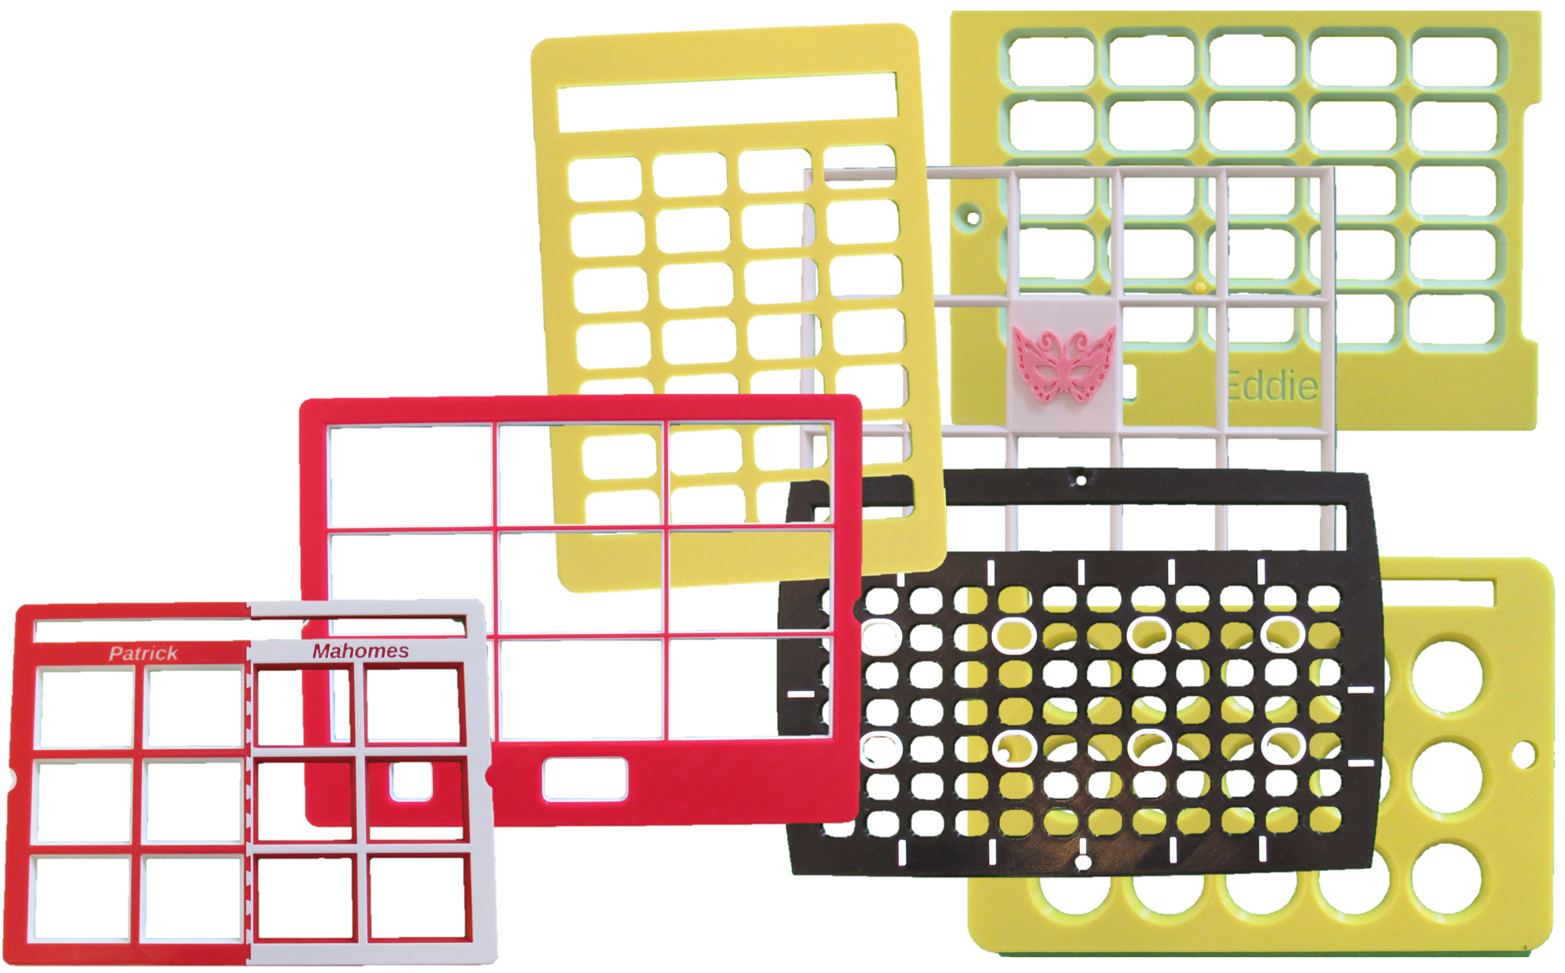
3D-Printed keyguards – from soup to nuts
Volksswitch.org
Ken Hackbarth (founder and CTO)
ken@volksswitch.org
* I have no Relevant Financial Relationships or Relevant Non-Financial Relationship to disclose.
Notes:
Good afternoon. Thank you for attending my workshop on 3D-printed keyguards. I hope, in these 3 hours, to share with you almost everything I know about designing 3D-printable keyguards for AAC apps. The workshop begins with the basics and progressively adds more specialized content.
My name is Ken Hackbarth, and you can see my email address on this slide. Note the two s’s in Volksswitch. Please feel free to contact me with any questions or ideas that you may have. You’re also encouraged to ask questions throughout the workshop by posting them in the chat. It will be a challenge to present and keep an eye on the chat window, but I hope to have answered all your questions by the end of the workshop.
If you haven’t already done it. Please download a copy of these slides and follow along with me. There will be times when I have a slide covered by another window and it will be helpful if you can refer to your copy of the slides for what may be obscured. Many slides have hypertext links to relevant pages on my website or to other websites. They should appear green and underlined.
I have no Relevant Financial Relationships or Relevant Non-Financial Relationship to disclose.

Slide 2
FYI, this workshop is being recorded…
If you didn’t register for this event, and are watching the recording instead, consider making a donation to TechACCESS of Rhode Island, the sponsors of this conference.
Notes:
This workshop is being recorded. I expect to have the recording posted on my website in the next couple of days on the “In the News” page.
If you’re not watching this workshop live, consider making a donation to the sponsor of this conference via the link on this slide.

Slide 3
Please post your questions in the chat…
We’ll take a 10 min break about halfway through the workshop.
Notes:
As I said earlier, please use the chat window to ask questions during the workshop. I’ll try to check the chat for questions before each slide change.
Also, we’ll take a ten-minute break at about the halfway point of the workshop.

Slide 4
What we will be talking about today…
Live printing of a “grid-based” keyguard
Why 3D-print a keyguard (or many keyguards)?
Examples of what’s possible with our free designer
Designing the keyguard (that we’ll be printing shortly) from scratch
Advanced “grid-based” features
Designing “hybrid” keyguards
Designing “free-form” keyguards
And more!
Notes:
Here’s what the workshop will entail:
We’ll 3D-print the same keyguard that we’ll be designing during the workshop. Because the printing process will take almost 3 hours, we’ll start the printing before we start designing – that’s backwards but we don’t have a choice.
I’ll try to justify why you should 3D-print your keyguards rather than purchase them from a commercial supplier
I’ll show you some sample 3D-printed keyguards and how I’ve organized them into 3 categories
We’ll step through the process of designing the keyguard that’s printing.
We’ll cover how you can add advanced features to your keyguard without leaving the simple designer user interface
We’ll talk about hybrid keyguards – which will probably become your most common type of keyguard.
We’ll open the door completely and show you how to design a keyguard for “almost” any app or keyboard.
Finally, we’ll leave tablets behind and talk about keyguards for other devices.

Slide 5
What we won’t be talking about today…
What is a 3D-printer and how does it work?
What 3D-printer should I buy?
What if I don’t have a 3D-printer?
How do I make sense of all the different 3D-printer filaments?
--- use PLA filament unless you can’t get the job done with PLA ---
PLA (Polylactic Acid) – derived from cornstarch rather than petroleum
We won’t be using the Thingiverse Customizer to design a keyguard. Instead, we will use a free, more fun, and more powerful tool called OpenSCAD.
Notes:
Just to manage your expectations, I want to be up-front about what we won’t be covering – though I do devote a few pages on my website to these topics:
I’m not going to talk about the mechanics of a 3D-printer or types of 3D-printers
I won’t be recommending a printer for you to purchase
There are lots of ways to get a 3D-print even if you don’t have a 3D-printer
We’re not going to talk about filaments
But I will say – use PLA (polylactic acid) unless it simply won’t do what you need.
If you’re already familiar with Thingiverse and have used the Thingiverse Customizer – we won’t be. It’s underpowered, fragile and, frankly, no fun!

Slide 6
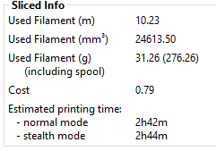
IN The interest of time… We’re going to put the cart before the horse… we’ll add the horse in a bit
Begin with a “completed” keyguard design – in the form of an STL file,
Open the STL file in a “slicer” and slice the model
note the estimated cost of the keyguard… 79 cents
also, note the time
Save the sliced design as a “gcode” file to an SD
Start the printer executing the gcode file
Check in on progress periodically
Notes:
As I said earlier, it can take several hours to print a keyguard and we only have 3 so we’re going to start printing our keyguard now, even though we haven’t, theoretically, designed it yet.
I’ve got the design ready to go in the form of an STL file.
I’m going to drag and drop it on a slicer program – in this case, PrusaSlicer, which came with my Prusa 3D printer
I’ll click on the “Slice now” button and because I’ve told the slicer in advance how much I paid for the 1 kg roll of the filament I’m using;
it can predict how much it will cost me to print the keyguard – 79 cents.
It can also predict, pretty accurately, how long the print will take. 2 hours and 42 minutes.
I’ll click the “Export G-code” button and put the sliced design on an SD card.
Move the SD card to the printer and begin the printing process.
We’ll check back periodically during the workshop.
Let’s do it…
[bring up Prusa Slicer and the ATCNE folder]

Slide 7
why a 3D-printed keyguard? (why not purchase a commercial keyguard?)
Cost-savings – often in excess of 95% over commercial, laser-cut keyguard
More mounting options than you’ll get from a laser-cut keyguard
Greater customization - better fit to the hardware, to the AAC software, and to the user
Greater personalization
raised and engraved elements
rainbow of color options
Notes:
Why am I 3D-printing the keyguard rather than purchasing it from someone?
The most important reason is the cost – you saw that it will cost me about 80 cents. It could cost me $80 or more to purchase a similar keyguard from someone else. If I mess up the design and the keyguard doesn’t fit, I’m only out 80 cents. If I mess up my order with a commercial business, I could be out $80.
Because there’s so much variation in tablet cases, you need several options for mounting your keyguard to the tablet and case. Commercial, laser-cut keyguards are made from a sheet of plastic, slide-in tabs are about the only possibility but that could make the screen protector ineffective.
Low cost and fast turn-around encourage you to work with the keyguard user to refine your design until it’s a great fit.
A highly personalized device is fun to use and fun to show off to others. 3D-printed keyguards can support embossed and engraved text and graphics. On the other hand, a sheet of acrylic comes in only a few colors. 3D-printing filaments come in an almost limitless number of colors.

Slide 8
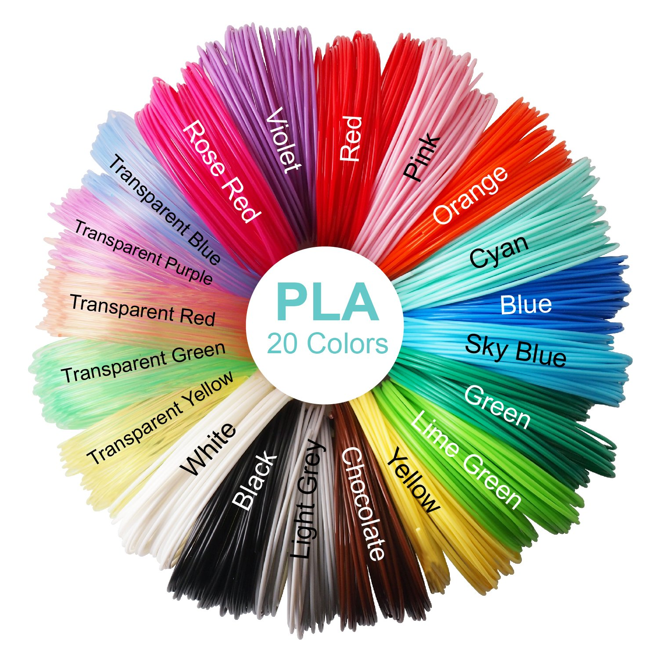
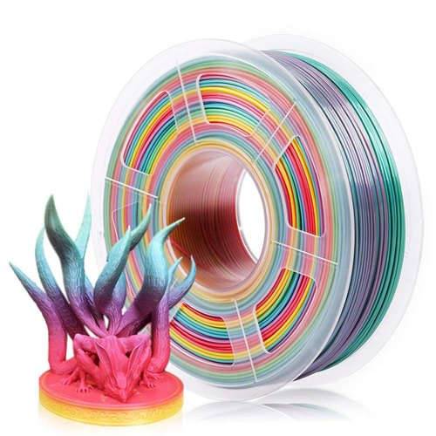
Just the tip of the PLA color-iceberg:
Notes:
On the left are just a few of the colors in which you’ll find PLA filament. You’re not seeing all the “silky” colors or the wood infused versions that can be lightly sanded. You can get filament the color of chocolate, but you can also get filament that “smells” like chocolate or coffee.
On the right is a roll of multi-color filament. The color automatically changes as the object is printed. We’re actually using a similar filament to print our keyguard today.

Slide 9
Two or Three Examples of What’s possible…
Grid-based
Hybrid
Free-form
Laser-cut (especially if you need something transparent or really large)
Notes:
I’d like to give you a sense of what the keyguard designer can do by showing you a couple of examples of each type of keyguard.
[open “live” camera]
Here are some “grid-based” keyguards. They have a region that is a grid of openings and they’re bordered by one or more horizontal bars that reach all the way from side to side. Each bar can be open or covered in plastic.
These “hybrid” keyguards look fundamentally like a grid-based keyguard but they’ve been augmented with special cuts, engraved or embossed text and images, and plastic added to the outer edge of the keyguard
These “free-form” keyguards have no grid at all. Every opening in the keyguard is explicitly described. You can replicate any grid-based or hybrid keyguard using free-form techniques, it’s just more work.
Here are a few a laser-cut keyguards produced from sheet of acrylic-styrene. You can use the keyguard designer to define these keyguards and have someone else like KeyguardAT (used to be called: Lasered-pics) produce the keyguard for you. Sheet acrylic is the only way you can produce a transparent or really large keyguard.

Slide 10
Designing our keyguard from scratch (Online Instructions)
Customizable, 3D-printable keyguard for grid-based, free-form, and hybrid AAC apps on tablets (https://volksswitch.org/index.php/volks-devices/fully-customizable-3d-printable-aac-keyguard-for-tablets/)
everything discussed today is also documented on this page and linked pages
note the short videos at the top of the page – they provide a great introduction to the topic
Notes:
Let’s talk about designing a keyguard from scratch – starting with online instructions
This is the web page you should turn to for instructions on how to use the keyguard designer.
You can be confident that everything I tell you today is described on the web site.
There are also four quick videos at the top of the page that will give you a good introduction to the designer and what’s possible.

Slide 11
Designing our keyguard from scratch (prerequisites to download/purchase/make)
OpenSCAD
keyguard.scad, data form, padding and bar size spreadsheet, info files
Windows: Paint/Notepad, Mac: Gimp/TextEdit
Easy Measurement Tool (EMT)
Metal Metric Rulers
Notes:
You’ll want to have several items on hand before you begin to design a keyguard.
OpenSCAD is a free tool that will support you in creating a 3D design simply by choosing values from pull-down lists.
We’ve created a program that uses OpenSCAD specifically for the purpose of designing keyguards
We’ve put together a data form for you to record the requirements for your keyguard,
a spreadsheet to help you take measurements for your keyguard directly from a screenshot of the app,
and finally, there are three files that end in .info which you will use to create hybrid or free-form keyguards.
You’ll need a graphics program and a text editor. Here are my suggestions – depending on what kind of computer you use.
Make an Easy Measurement Tool. It will help you get accurate measurements of your case.
Purchase a small collection of metal metric rulers. The world of 3D-printing is entirely metric.

Slide 12
Designing our keyguard from scratch (Gathering Pictures)
Images to collect:
photo of app running on the tablet in its case
screenshot of app running on the tablet (hold power button and press the home button)
get the screenshot to your PC/Mac in a way that preserves every pixel
Folder content… (demo…)
Notes:
Your first step is to collect three images:
a picture of the app being used, running on the tablet being used, in the case being used, oriented as it will be when it’s used
take a screenshot of the app in the layout for which you’d like a keyguard
save the screenshot as a file on your computer – check the screenshot and ensure that you haven’t lost any pixels along the way
Let’s look at a folder containing all the files you’ll need to design your keyguard
[open workshop folder]

Slide 13
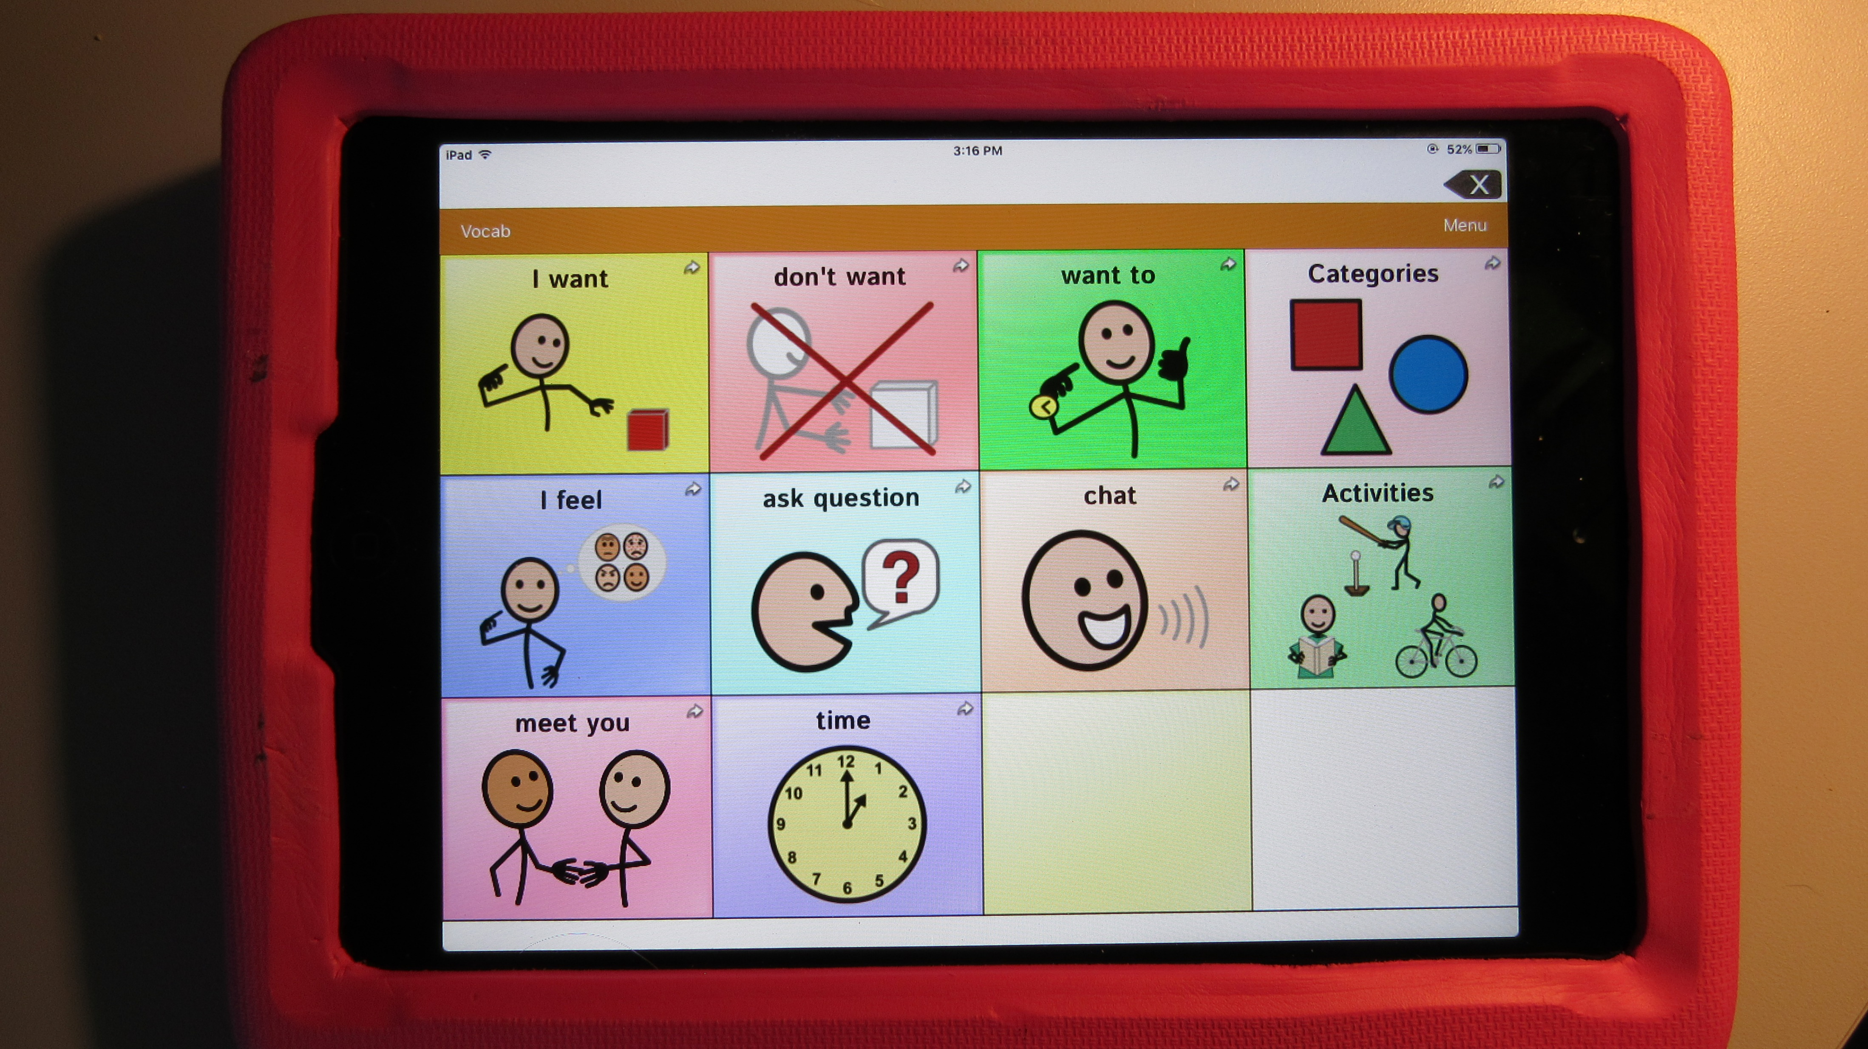
Designing our keyguard from scratch (TouchChat, on an iPad mini, in A rubbery case)
Notes:
Here’s the app, tablet, and case for which we’ll design our keyguard
It’s impossible to see from this picture, but the case has some supports on the back that lift the top upward. To use the tablet in this orientation, the home button is on the left and the camera is on the right. The designer normally assumes the opposite – we’ll account for this shortly.
[Show and tell… bring up “live” cam]

Slide 14
Designing our “Hybrid” keyguard from scratch (…The plan)
expose the Vocab control
cover the Home button completely
expose the camera
keyguard ID on back:
“workshop”
workshop
Notes:
Let’s talk about the plan for our keyguard
The green doodle shows an approximation of what we’d like our keyguard to look like.
We have some specific requirements for our keyguard:
we want to cover the command bar but expose the Vocab button on the left end
we want to completely cover the Home button but expose the camera
And last, we want to engrave the word “workshop” on the back (or underside) of the keyguard as the identifier. That will make the design easier to locate if we need a replacement keyguard.
[bring up “keyguard” cam]

Slide 15
Designing our keyguard from scratch (artist’s rendering)
workshop
Notes:
Here’s what we expect the keyguard to look like without all the distractions.
Let’s take a look at the currently printing keyguard and see if we’re on the right track…

Slide 16
Designing our keyguard from scratch (starting to design – Keyguard.scad)
The OpenSCAD/keyguard.scad UI (demo…)
visualization of current keyguard design
Customizer region – note similarity to data form
step through options from top to bottom – matches instructions on web page
Notes:
Let’s start the design.
[bring up the “workshop” folder]
OpenSCAD is already downloaded and installed on this PC so we can launch the keyguard designer just by double clicking on the keyguard.scad file (that’s just like double clicking on a DOC file to start Microsoft Word and load the document).
[double-click on keyguard.scad]
On the left a visualization of the keyguard as currently specified. In this instance, it’s just all the default settings of the designer. We’ll need to use the mouse wheel to scroll back to see the entire keyguard. The options you can set to define your keyguard are on the right. This pane is called the Customizer.
You start at the top of the pane and work your way downward.
This matches the layout of the web page and the layout of the data form.
[bring up web page and data form]

Slide 17
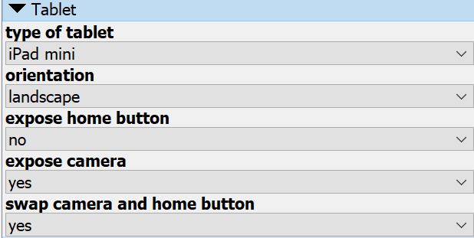
Enter Tablet Information into the designer
Demo…
Notes:
We’ll skip the “Type of Keyguard” section for now and start with the “Tablet” section.
We need to set the type of tablet to “iPad Mini”, hide the Home button and expose the camera.
Finally, we’ll swap the camera and Home button locations because they’re on the opposite ends of the tablet in this orientation.
Let’s do it…
[bring up OpenSCAD and insert Tablet options]

Slide 18
Designing our keyguard from scratch (The case is critical!)
The designer supports designing keyguards for tablets with no case but that is very rare.
The size of the keyguard is determined by the size of the case opening
Your mounting options are completely determined by the case
@#!^ screen protectors!
Collect case opening width, height, and corner radius. (match the orientation)
Notes:
Next is the Tablet Case section of options…
First of all, the keyguard designer can help you design a keyguard for a tablet that doesn’t have a case but that almost never happens. Everyone puts their tablet in a case to protect it. The case will have a lot to say about your keyguard.
Your keyguard will sit within the opening in the case. That opening is always smaller than the tablet itself so you may find that the tablet is larger than your 3D-printer but you can still print the keyguard .
Your goal is to mount the keyguard securely to the tablet but that will often require that you leverage aspects of the case to hold the keyguard in place. Screen protectors create special problems! More on that later…
The designer needs to know the case opening width, height and corner radius. Remember to pay attention to the tablet orientation when taking these measurements.

Slide 19
Designing our keyguard from scratch (Using the EMT to collect case measurements)
Get an EMT! Don’t try to use a ruler – you can’t avoid parallax issues.
Live demo…
Notes:
It’s very hard to measure the size of the screen opening accurately with a ruler. That’s why we created the Easy Measurement tool.
[bring up “live” cam]

Slide 20
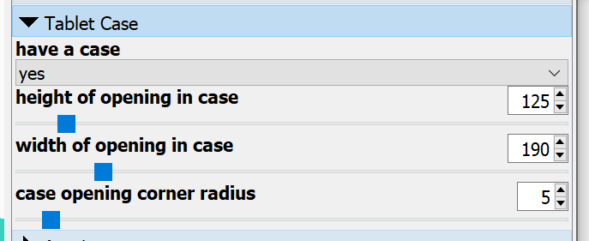
enter Tablet and Case Info into the designer
190
Demo…
125
corner radius: 5
Notes:
Now we enter those numbers into the designer.
You can type the numbers directly into the spinner controls or you can use the slider. It’s hard to get accurate with the slider but if you type the number directly in, you have to press Enter after you’re done.
Let’s do that…
[bring up OpenSCAD]

Slide 21
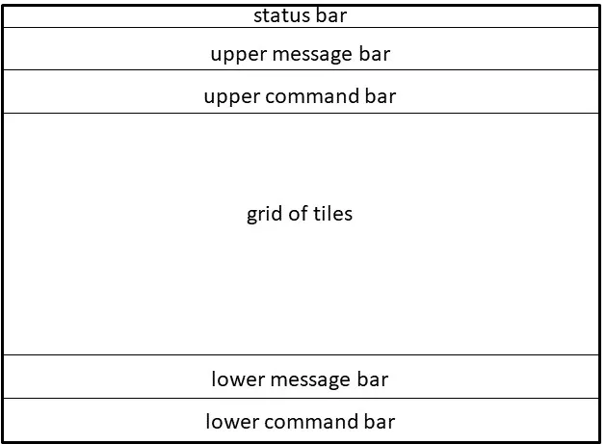
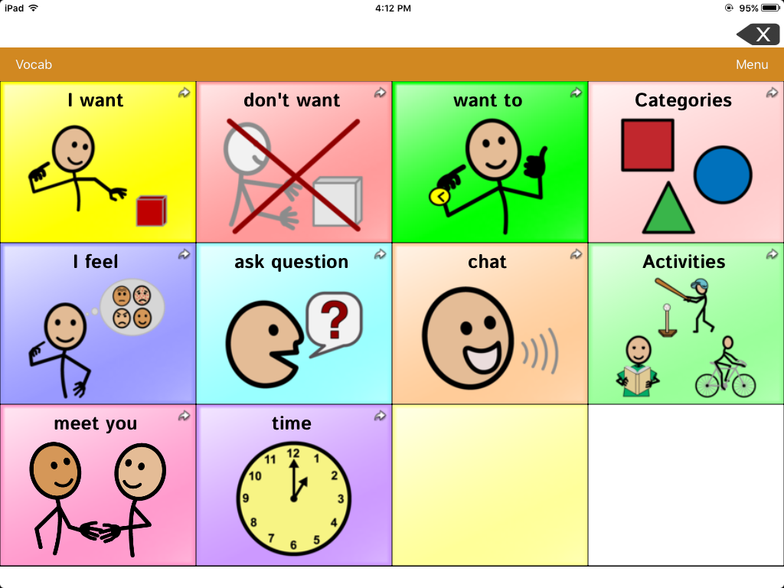
Designing our keyguard from scratch (first, some terminology)
Grid-based AAC apps have a consistent layout:
Notes:
Next, we’ll gather the measurements of the AAC app itself – but first let’s talk about the regions of the screen. The designer is going to be interested in how much vertical space these regions take up.
All grid-based AAC apps have a consistent layout of message and command bars.
The status bar on an iPad contains the time and battery level and is displayed at the top. Sometimes you set up the app to hide this bar.
A message bar is normally where the selected text appears while a command bar is normally where the app puts commands that change the layout of the app or access other features of the app.
Sometimes the message bar is at the top of the screen, and sometimes you find it at the bottom. Sometimes the command bar is positioned below the message bar and sometimes one is above the grid while the other is below.
Note that we call the bar below the status bar the upper message bar, but what if, for your app, that was a command bar and the message bar was below that?
No problem. These are just names. Use the message bar option to record the size of your command bar and vice versa.
If you don’t have one of these bars, just leave its height at zero. The TouchChat app pictured on the right has a status bar, an upper message bar and an upper command bar. The app has been configured to support a keyguard that’s why there’s the white region below the grid. We’ll just treat it as a lower message bar to account for the space it takes up on the screen.

Slide 22
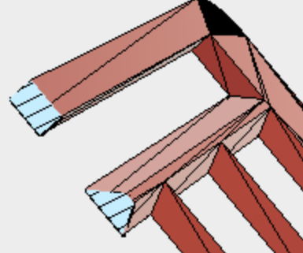
Designing our keyguard from scratch (Entering app measurements)
Remember that the “message” and “command” bar references are arbitrary. They just refer to a region of the keyguard that can be open or covered in plastic. They can be 0 mm high if they don’t exist.
If you can do it, a bar slope can provide the user with visual and manual access to a part of the screen that would otherwise not be accessible through the keyguard.
Notes:
So, one more time… Don’t get thrown by the name that a bar has in the designer. The message bar is just the bar on top and the command bar is the bar below that. If your app is different, just call the bar on top the message bar and the bar below that the command bar. If you don’t have one or more of these 4 bars, just leave their heights at 0.
Note that smaller tablets can have very thin message bars. They’re not a problem until you add a keyguard. Then you may not be able to see what’s going on in the bar or fit your finger in to delete words or play the phrase. You can provide better visual and manual access to the message bar by adding a bar slope. This is not possible with a laser-cut keyguard because all cuts have to be perfectly vertical.
We have a small tablet with a thin message bar so we will definitely be adding a bar slope – and then we’ll have to compensate for adding that slope… There are always compromises.

Slide 23
Designing our keyguard from scratch (measuring the app)
You “can” measure the layout of the app using a ruler but it’s so much more accurate to use a graphics program to “measure” your screenshot.
Allow the “padding_and_bar_size.xls” spreadsheet to prompt you for what’s needed and to do the calculations for you.
A few pixels here or there aren’t critical. The final number you enter into the designer will represent whole millimeters. So, don’t kill yourself positioning the cursor in the graphics program.
Notes:
So how are we going to get these measurements of the app’s layout?
While you “could” measure the layout of your app with a ruler, we’re going to use a more accurate method. We’ll use a graphics program to count pixels in your screenshot.
(That’s why it’s so important to get a good screenshot of your app. “Good” means that the screenshot was taken of the app running on the actual tablet that is going to be used with the keyguard. Then, you have to get it to your PC without losing any pixels. Images that are simply pasted into the body of an email message are often compressed by the email program and you can lose pixels as a result.)
We’ve created an Excel spreadsheet to help get the right measurements and do the calculations for you. It’s called “padding_and_bar_size.xls”. You’ll be moving the cursor around in a graphics program to get these measurements.
It can be difficult to carefully position the cursor in the graphics program. You may find that it helps to zoom in on the image, but don’t kill yourself getting measurements. A few pixels here or there won’t matter.

Slide 24
Designing our keyguard from scratch (Collecting App measurements)
Layout of spreadsheet – inputs and outputs
Note: the spreadsheet assumes that measurements are being taken from the upper left corner of the screen: where x=0 and y=0. If your graphic program doesn’t work that way let us know.
X increases as you move the cursor down the screen and Y increases as you move the cursor from left to right.
Notation we’ll use in this workshop for a specific screen location: (x,y)
The number of pixels in the x and y directions for a particular location can be found in the lower left corner of the MS Paint screen: x, y px
Notes:
[open the spreadsheet]
Let’s look at the layout of the spreadsheet. Start buy finding the row that represents your tablet. The values you’re going to collect will be in number of pixels and go in the first set of columns. The column headings tell you what to measure and put in that cell. The columns at the end are millimeter values that you will type into the designer.
We’re going to use Microsoft Paint for our measurements and Paint calls the upper left corner of the image, the zero/zero location. If your graphics program puts zero/zero someplace else, let us know and we’ll create a custom spreadsheet for you.
[open Paint]
Moving the cursor from left to right increases the X value, and from top to bottom increases the Y value.
Look in the lower left corner of Paint. That’s where it tells you the X and Y coordinates of the current cursor location.
Let’s take these measurements using our screenshot. I’ve already written them down, so I won’t be moving between Paint and Excel with each measurement.
[add measurements to spreadsheet]

Slide 25
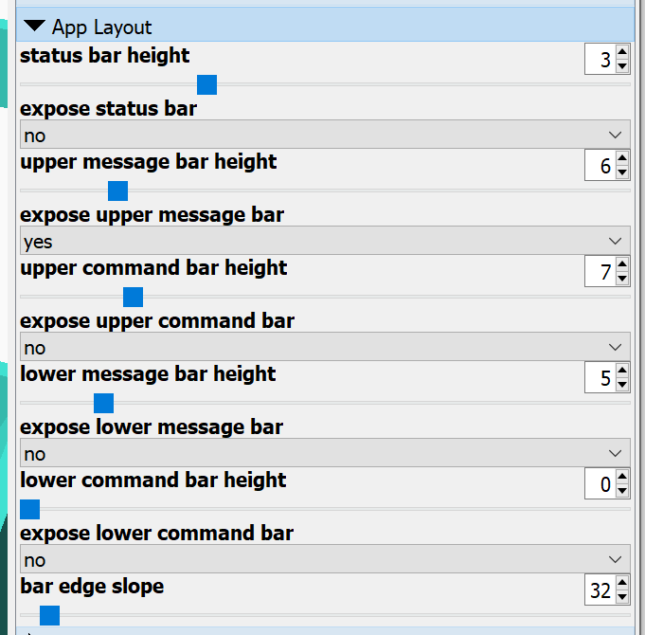
Enter Results into the Designer…
Demo…
*
Notes:
Now let’s enter the calculated data into the designer
*And last, we’ll see how setting the bar slope at something less than 90 degrees can make it easier to see and access the message bar.
[bring up OpenSCAD]

Slide 26
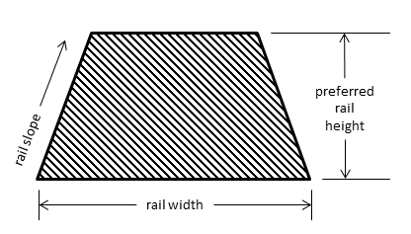
Designing the same keyguard from scratch (special grid topics – the rails)
The keyguard will be as thick as the rails between the buttons.
The thickness of the rails is affected by 3 values: width, slope, preferred height.
You always get the rail width and rail slope that you ask for.
Note: if you set the rail slope at 90 degrees, you can make the keyguard as thick as you want (i.e., whatever your preferred rail height is set to).
Notes:
The horizontal and vertical rails between the openings in the grid are probably the whole reason for your keyguard so let’s understand what drives them…
In the Grid Layout section of the Customizer, you specify the rails, and the rails determine the thickness of the keyguard.
There are three options you need to understand to make sense of what is happening. Here’s a picture of a cross-section of a rail between the openings in the grid. The rail width is how wide the rail is at the bottom. The rail slope is the angle of the sides of the rail – note that a laser cut keyguard always has 90-degree rail slopes. The preferred rail height allows you to control the height of the rail.
The designer will ensure that you get the rail width that you want and the rail slope that you want. You can increase the preferred height only so far before the rail becomes a triangle and won’t get any taller. The larger the rail slope and the greater the rail width, the taller the rails can be. And since the keyguard is only as thick as the rails are tall, you also control the keyguard thickness this way.
If you set the rail slope to 90 degrees, you can make the keyguard arbitrarily thick. Basically, what ever you set for the preferred rail height becomes the thickness of the keyguard.

Slide 27
Enter Grid Settings into the Designer…
Padding:
Demo…
Notes:
The screenshot will tell you the number of rows and columns in the grid and the shape of buttons. Our app has 4 columns and 3 rows, and each button is rectangular.
The output region of the spreadsheet will tell you the amount of space between buttons vertically and horizontally. You can think of this number as the minimum width of the rails – you can go wider if you don’t mind covering part of the buttons. The spreadsheet will also tell you if you need to add padding to the grid. You’ll need padding if the buttons aren’t distributed evenly horizontally and vertically.
Other options in this section can be used to cover and merge openings and put ridges around openings. I’ll talk about those options later.
For now, let’s enter the remaining spreadsheet data into the designer and experiment with some of the values.
[bring up OpenSCAD]

Slide 28
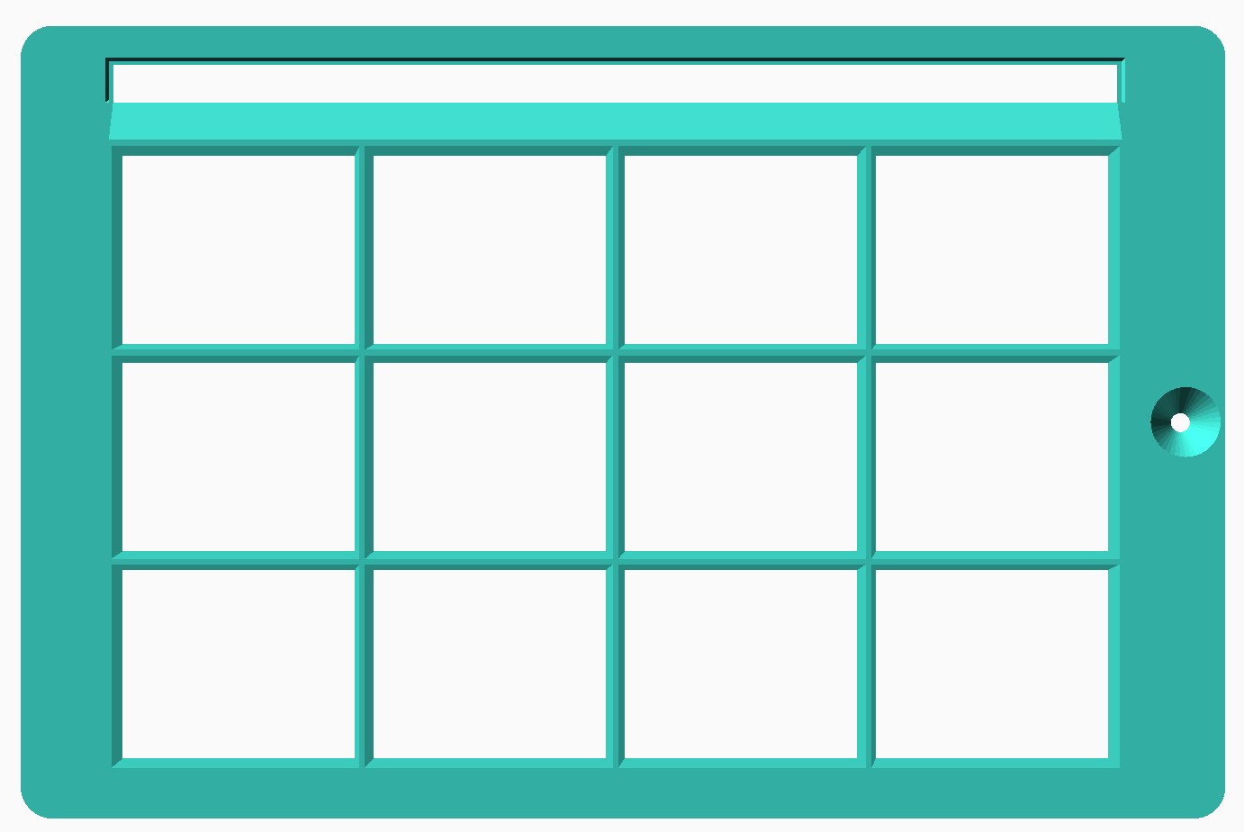
Are we done?
workshop
Notes:
So, are we done?
Not quite. We still need to:
create an opening for the Vocab button
extend the keyguard out to cover the Home button completely
etch the word “workshop” into the back of the keyguard

Slide 29
Designing our “hybrid” keyguard from scratch (arbitrary openings, additions, and engraving)
Our keyguard is a “hybrid”, because, along with a having a basic grid, it involves special cuts and/or additions:
a rectangular cut in the command bar to expose the “Vocab” button
a small rounded-rectangle added to the perimeter to cover the rest of the home button
the ID of the keyguard (“workshop”) engraved on the back surface
The instructions for these cuts/additions go into “.info” files
Notes:
If we stopped where we are right now, we would have designed a “grid-based” keyguard, but, because we adding these three special features, we actually have a “hybrid” keyguard.
A hybrid keyguard starts as a basic grid but then adds a few cuts and/or additions – in this instance, a rectangular cut, half of a rounded rectangle added to the perimeter, and a bit of engraving. Note that the word “engraving” is a euphemism for not putting plastic there.
We’ll tell the designer to add these features by putting special instructions in the three “info” files.

Slide 30
Designing our keyguard from scratch (more terminology: The screen)
(0,0)
– or –
(0,0)
measurements in pixels or millimeters
Notes:
The cut-out in the command bar for the Vocab button will be placed in the area of the screen. What are we calling “the screen”?
The screen is the part of the tablet that lights up when you turn the tablet on. It’s also the collection of pixels that are captured when you take a screenshot.
The designer will let you determine the coordinates of your “cut” relative to the upper-left or lower-left of the screen.
It will also let you make your measurements in pixels (using a graphics program) or in millimeters (using a metric ruler). We’ll measure in pixels because we’ll be using Paint and our screenshot to get these measurements.
You set these last two options in the “Free-form and Hybrid Keyguard Openings” section of the customizer.

Slide 31
Designing our keyguard from scratch (Vocab Opening: screen_openings.info)
x
(0,0)
width
y
r
(80,57)
height
(x,y)
(0,95)
x = 0
y = 95
height = 95 – 57 = 38
width = 80 – 0 = 80
shape = “r”
Notes:
Here’s a piece of the screenshot in Microsoft Paint showing the Vocab button
Remember that Microsoft Paint sets the 0,0 location in the upper-left and that the X coordinate increases as you move to the right while the Y coordinate increases as you move down.
Let’s plan to make a rectangular cut to expose the Vocab button
The designer requires 4 measurements to cut an arbitrary rectangular opening in the keyguard. It needs the height, the width, and the coordinates of the lower-left corner of the cut
If we move the cursor to the lower-left corner of the opening, the coordinates are x=0 and y=95
To determine the height and width of the rectangle we’ll also get the coordinates of the upper-right corner. X=80 and y=57.
Then, with just a little arithmetic, we have all the information we need. Note that we specify a rectangular cut by using the letter “r” as the shape

Slide 32
Designing our keyguard from scratch (info file structure)
This is the business-end of the file. (The first part of the file is just hints and instructions):
Lines that start with “//” are ignored.
Data lines contain square brackets and end with a comma except the last data line.
Columns are just for your benefit. They mean nothing to the program.
Notes:
We need to put the information for the cut into the “screen_openings.info” file. Let’s begin by looking at the structure of the info file. You can edit the info files with any simple text editor – like Notepad on Windows and TextEdit on a Mac. Don’t use a more complex editor like WordPad or Word because they can end up inserting special characters into the file that will confuse the designer. The file starts with a lot of explanatory information that you can refer to if you want. We’ll be making our changes at the bottom of the file.
The designer will ignore any lines that begin with two forward slashes.
The data lines start and end with square brackets. Each should end with a comma – except the last data line.
The data appears to be arranged in columns but that’s just for your benefit. The designer just wants the items in a data line to be separated by commas and any text to be enclosed in double quotes.

Slide 33
Designing our keyguard from scratch (Custom screen “opening”)
need to delete this comma
Watch the keyguard image update automatically when the info file is saved (ctrl-s)
Live demo…
Notes:
What does the data for the “Vocab” cut look like in the file…
We’ll start by adding the x, y, width, and height values for our rectangular cut to the info file and remove the double slash at the start of the line
We also need to remove the comma at the end of the line – the other lines are ignored so this is our final line of data.
The nice thing about OpenSCAD is that it is watching for changes to this file so it will update the image of our keyguard each time we save the info file (in Windows we can do this by typing control-s ).
Let’s make those changes in reality and watch the design update
[open screen_openings.info file]

Slide 34
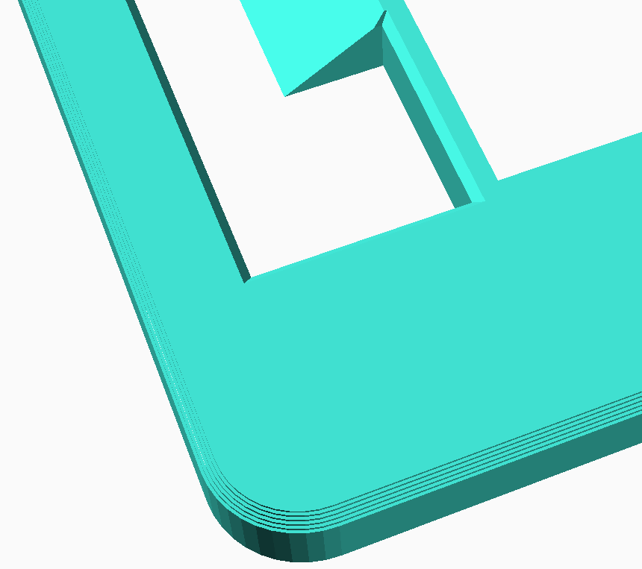
Designing our keyguard from scratch (Safety First)
Too pointy… Let’s round that corner.
Notes:
We should always be looking for things that may make our keyguards less safe… Let’s round this corner so there’s less chance of it getting caught on something.

Slide 35
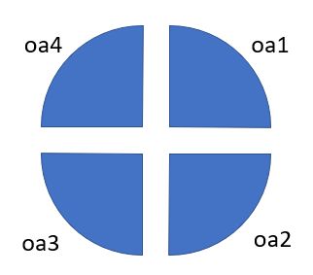
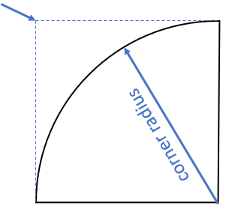
Designing our keyguard from scratch (Outer Arc: screen_openings.info)
(x,y)
(80,57)
shape = “oa4”, x =80, y = 57, corner radius = ? let’s try some different values…
remember that the units are pixels (which are really small)
Notes:
There are several more kinds of cuts that we can make to the keyguard.
This is the corner we’d like to round off.
We’ll use something called an outer arc to do that. There are 4 possible outer arcs.
We’ll use an outer arc 4.
To place and outer arc, you need to specify the coordinates of the point you're trying to round off and the radius of that cut.
The coordinates of the point are x=80 and y=57
So, here’s what we’ll put in the screen_openings.info file as a new instruction. The shape will be an “oa4”. x will be 80, y will be 57, and the corner radius we’ll play with until we get what we like. Don’t forget that we’re working in pixels which are much smaller than millimeters.

Slide 36
Designing our keyguard from scratch (Custom screen “opening”)
remember to reinsert this comma
Watch the keyguard image update automatically when the info file is saved (ctrl-s)
Live demo…
Notes:
We’ll enter this data in a new row. We’ll delete the double slashes at the start of the data row and remove the comma at the end.
Which means we need to reinsert the comma at the end of the first data row.
Once we’re done, we’ll type control-s and watch the design update.
Let’s make those changes in reality
[return to screen_openings.info file]

Slide 37
Designing our keyguard from scratch (Much Better)
Notes:
We’ve rounded the corner. You can use the mouse wheel to move in close to see the curve more clearly.

Slide 38
Designing our keyguard from scratch (more terminology: The case)
measurements in millimeters only
(0,0)
Notes:
The engraved text will go on the outer portion of the keyguard. We aren’t going to position this text relative to the screen, instead we’ll place it relative to the outer edge of the keyguard. That means within the case opening.
When you measured the case opening, you defined the “case” region of the tablet.
Features in the case region are located relative to the lower left corner of the case opening.
Measurements are aways done in millimeters because you can’t use a graphics program to count pixels outside of the screen region.

Slide 39
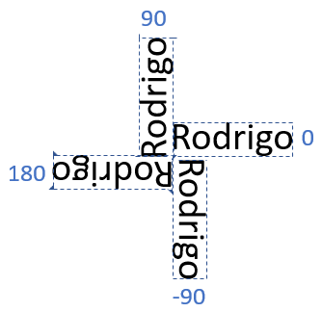
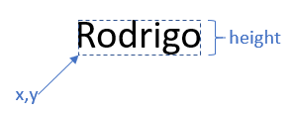
Designing our keyguard from scratch (engraved text: case_openings.info)
top slope:
shape: ttext vs. btext
top slope: direction
bottom slope: font style
(0=normal, 1=bold, 2=italic, 3=bold italic)
other: “text to engrave”
workshop
in the area of the case, not the screen
shape = “btext”, top slope = 0, bottom slope = 1, other = “workshop”,
x =?, y = ?, height = ? let’s try some different values…
remember that the units are millimeters now (bigger than pixels…)
Notes:
Now we’ll engrave the ID of the keyguard on the underside.
Because the cut will go in the case region rather than the screen region, we’ll put the instruction in case_openings.info.
We can control the direction of the text by the number that we put in the “top slope” column. In this instance we’ll be using the standard direction and put a zero in this column.
Next, we need to specify the coordinates of the lower left corner of the text (including descenders) and the height.
The “shape” in this instance is “btext”, meaning the text will go on the bottom or underside of the keyguard. We can also set the font style by what we put in the “bottom slope” column – we’ll put a 1 there for “bold”.
So, here’s what we’re going to put in the case_openings.info file. Text on the back of the keyguard is challenging to position so we’re just going to experiment. Remember that the case_openings.info file assumes all measurements are in millimeters, which are much bigger than pixels.

Slide 40
Designing our keyguard from scratch (Keyguard “ID”)
Especially with text placement, it’s best to just put some values into the info file and then adjust those values when you see what your design looks like. It’s even more mind-bending when you’re working on the underside of the keyguard.
If you can’t see your text clearly, it might be hiding over an opening in the keyguard. It can help to temporarily set the number of columns or rows in the grid to 0 which will give you a solid block of plastic.
Notes:
Positioning text on the back of a keyguard is a bit challenging.
So, we won’t think too hard, we’ll just put our text a particular set of coordinates and see what happens.
A bunch of button openings can make it hard to see our “engraved” text so, we’ll start by setting the number of columns to zero. The keyguard will become a solid slab and the text will be easier to see, especially when, at first, we’re not sure where it is going to show up. Note that we could have done this by setting the number of rows to zero as well.

Slide 41
Designing our keyguard from scratch (Case_openings: Keyguard “ID”)
Live demo…
Notes:
Here’s the data we’ll add to the info file. We’re going to update and save the file repeatedly until we get what we want.
Let’s make those changes in reality and watch the design update
[edit case_openings.info file]

Slide 42
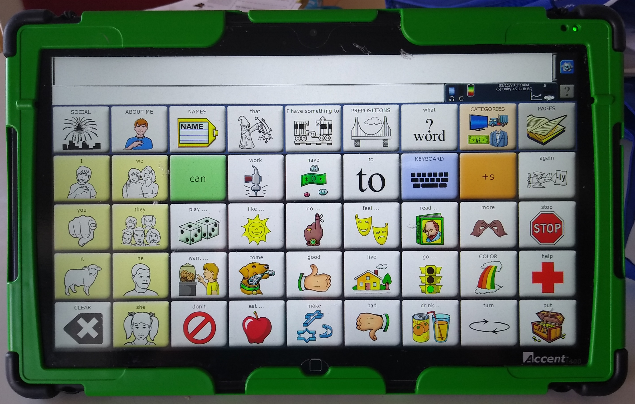
Designing our keyguard from scratch (Case Additions)
If the case opening isn’t perfectly and completely rectangular, you may need to add more plastic to the perimeter of your keyguard.
Keyguard perimeters can be even more complex by adding other kinds of shapes.
In our example, we want to cover the entirety of the Home button so the keyguard needs to “reach out” to the left.
Notes:
Most cases have a rectangular opening. Even if the corners are curved, the opening is basically rectangular. But sometimes, they’re not – Accent systems are a well-known example.
If the case opening isn’t rectangular, you can add plastic to the outside of your design so that it more completely fits the opening. These instructions go in the case_additions.info file.
The designer supports adding many different shapes to the outside of your keyguard so it can have a fairly complex perimeter.
[show Accent 1400 keyguard on “live” cam]
Our example keyguard needs more plastic on the left so that it can completely cover the Home button.

Slide 43
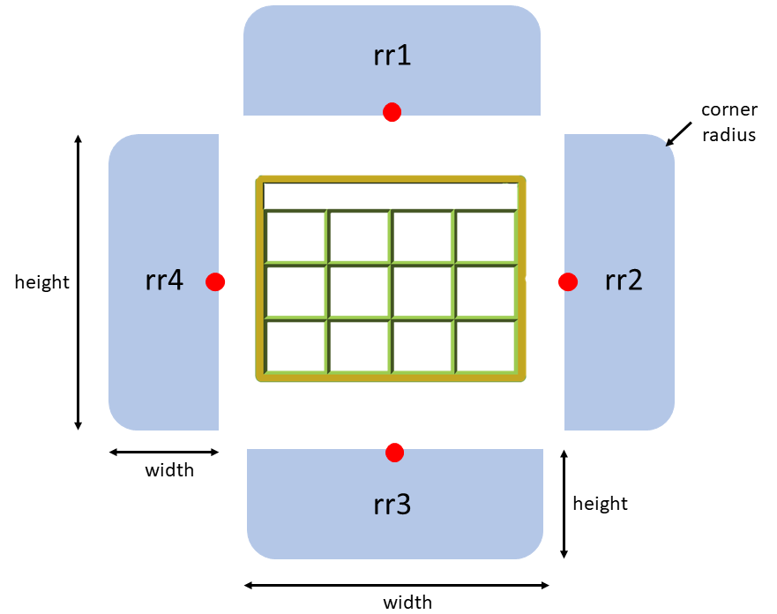
Designing our keyguard from scratch (case Addition: case_additions.info)
62
36
4
again, measurements in millimeters
x,y
44
x = 0, y = 62, width = 4, height = 36,
corner radius = ?, shape = “rr4”
Notes:
Our case opening has a small cut-out on the left to expose all of the home button. We don’t want any of the home button exposed so we need to add some plastic to fill this space.
The plastic will be 4 mm wide and 36 mm long.
Its center is located 62 mm up from the lower-left corner of the case opening. Like the case_openings.info file, the case_additions.info file assumes that all measurements are in millimeters and that they’re taken from the lower-left corner of the case opening.
We’re going to use a rounded-rectangle (actually half of a rounded rectangle) to fill this space. We’ll need to specify the height, width, corner radius, and the coordinate of the center point.
In this example, the rounded rectangle we’ll be adding is this one. An “rr4”.
The data we need to add is mostly known at this point. X = 0 because the center is aligned with the left edge of the case opening. Y is 62, width is 4 and height is 36. The only thing that’s not clear is the corner radius. We’ll just see what looks good. It doesn’t need to be perfect.

Slide 44
Designing our keyguard from scratch (Adding Plastic: case_additions.info)
Live demo…
Notes:
Let’s try adding that data to the case_additions.info file and see how the design looks each time we save the file.
[edit case_additions.info file]

Slide 45
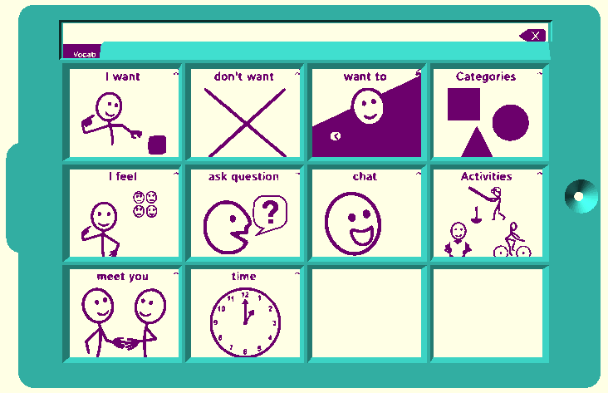
Designing the same keyguard from scratch (Fit to App?)
Use your screenshot to test your layout.
Use the free program Inkscape to convert your screenshot to SVG format.
Live Demo…
Notes:
Staring at a representation of your keyguard in OpenSCAD may be rewarding but you’re bound to feel unsure about how well the keyguard will fit your app.
It turns out that you can use the same screenshot that you took measurements from to test your keyguard design.
The first step is to convert your screenshot from JPG or PNG format to SVG format. We’ll use the free program Inkscape to do this.
We can then display your converted screenshot behind the keyguard and see how things align.
Let’s try it…
[Drag and drop screenshot onto Inkscape]
Remember to turn off the display of the screenshot when you are comfortable with the fit otherwise OpenSCAD will be very sluggish.

Slide 46
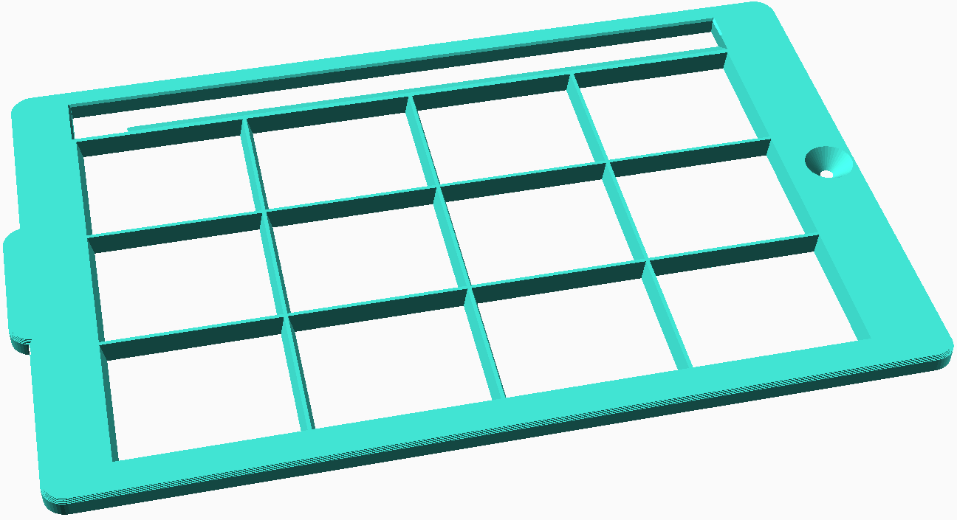
Designing our keyguard from scratch (Fit to case?)
It’s smart to print the first few layers of your keyguard and check the fit before printing the entire keyguard.
Special Actions and Settings:
Show and tell…
Notes:
The keyguard looks good at first glance. Unfortunately, there’s no virtual way for you to test the fit to the case opening
You can get a really good idea of the fit without printing the entire keyguard – just the first couple of layers. So set “first two layers only” to “yes” in Special Actions and Settings. Note, you can make the test keyguard print even faster by ignoring the screen region and setting “cut out screen” to “yes” as well, but this is a good time to test the fit of the keyguard to the app and grid too, so we’ll leave that option set to “no”.
I’ve done that already with our example keyguard and this is what the test keyguard looks like.
[show test keyguard in “live” cam]

Slide 47
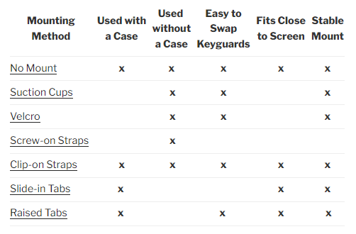
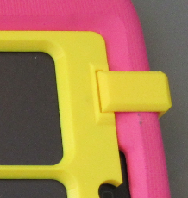
Designing our keyguard from scratch (Mounting Options)
Show and tell…
Notes:
We’re close to done but we need to decide how we’re going to attach the keyguard to the tablet and case.
This table shows all the mounting methods that you can choose among for your keyguard. The table attempts to describe characteristics for each of the methods. Note the three methods that methods that can’t be used with a case.
We’re going to ignore these three methods – primarily because tablets are almost always used with a case in this domain. Another reason is because micro-suction tap works better than all these methods anyway. We’ll talk more about micro-suction tape later.
Clip-on straps involve using a set of 3D printed clips that snap into grooves in the top of the keyguard.
You’re probably already familiar with slide-in tabs. You find them on most commercial, laser-cut keyguards.
Raised tabs attach to the top surface of the case rather than sliding under the edge of the case opening.
Let’s see what they look like in real life
[show with “live” cam]

Slide 48
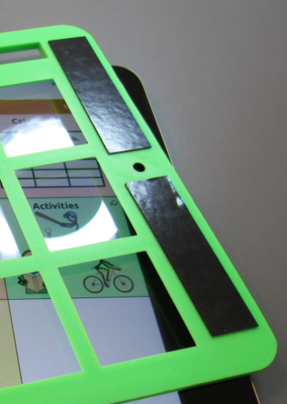
Designing our keyguard from scratch (My favorite Mounting method: micro-suction tape)
Show and tell…
Notes:
Last, there’s a mounting method called “No Mount”. That just means that nothing special is included in the design for this method. Instead, the keyguard is simply squeezed into place or attached with, micro-suction tape.
Let’s see an example
[show with “live” cam]

Slide 49
Designing our keyguard from scratch (How to choose a mounting method)
“No-Case” Mounting Options
Suction cups, Screw-on straps, Velcro – but micro-suction tape works so well, they're hard to justify
Case Mounting Options
No mount – wedge into case or use micro-suction tape
the keyguard must have solid plastic, at least 8 mm wide, to put the micro-suction tape on in several places – you can increase the difficulty of removing the keyguard by loading up on tape
Clip-on straps
requires more border space around the screen than raised tabs but more reliable with clients who want to pull off the keyguard
Slide-in tabs
good for a rubbery case with no screen protector, it’s hard to remove the keyguard – both a pro and a con
Raised tabs
may be the last resort for cases with screen protectors and thin rails
✓
Notes:
How do you choose a mounting method.
As you saw on previous slides, the designer supports mounting your keyguard to a tablet that has no case.
And as I said, these methods are hard to justify given that micro-suction tape holds so well to glass without leaving any residue when removed.
There are several ways to mount a keyguard to a tablet inside a case. Each will have its strengths.
The No Mount method works well if you can wedge the keyguard into the case opening or if you can use micro-suction tape. Wedging only works if you have a soft, rubbery case and a student who’s not too focused on pulling the keyguard out. In order to use micro-suction tape, you must have several areas of the keyguard with enough plastic to attach the tape to.
Clip on straps require that there be enough plastic around the edge of the keyguard for the clip to snap into, but the clips are very difficult for a student to remove.
Slide-in tabs work with rubbery cases that don’t have a screen protector. They’re difficult for a student to remove but that means it can be tough for the instructor to remove as well.
Raised tabs can save the day when you have a case with a screen protector that fits very close to the active region of the screen – meaning that the perimeter of the keyguard is very thin.
For our keyguard, the winner is…. the No mount mounting method. We’ll be using micro-suction tape.

Slide 50
Creating An STL file (Finally, the HORSE gets harnessed)
Save the Preset for your design
Choose: Design > Render
This process can happen quickly or take several minutes depending on the speed of your computer and the complexity of your keyguard.
Now Export your design as an STL file.
Give the file the same name as your preset and put it with the other supporting files for your keyguard
Live Demo…
Notes:
No Mount is the default mounting method so there’s nothing additional that we need to do. We’re finally ready to save our design and prepare it to be printed.
We’ll save our current settings by saving the preset, just in case we need to come back and change something – or create another keyguard that is very similar.
Next, we’ll Render the design.
If you’re ever going to feel the need to upgrade your computer, you’ll feel it now! The more complex your design, the longer this step will take.
Last, you’ll export your design as an STL file. The designer will try to give your design a generic name – change it to the same name you used for your preset.
If you remember, our keyguard magically started out as an STL file in this workshop. So, we’re getting back where we started. Let’s see what that process looks like.
[back to OpenSCAD to save Preset then render and export the model]

Slide 51
Advanced Grid-Based Concepts
Unbalanced cases (turns out we have one in our example)
Merging and covering cells in the grid
Putting ridges (tactile landmarks) around cells
LWFL-VI keyguard is an example application
Handling tight-fitting cases (i.e., screen protectors)
Splitting a keyguard that is too large to print in one piece
Managing multiple keyguards
Creating Braille inserts
Notes:
Strictly speaking, a “hybrid” keyguard means that you have added some instructions to an info file. There’s a lot more customization that you can add to your keyguard without having to put anything in an “info” file.
These are all “grid-based” features since you can make them happen directly in the Customizer pane.
We’ll look at each feature in the next few slides and see how they can affect the look of a keyguard.

Slide 52
Advanced Grid-Based Concepts (Unbalanced cases)
When the screen doesn’t sit in the center of the case opening
Can be intentional (Lifeproof NÜÜD case) or just a poorly fitting case (our example)
Support for these issues in the Special Actions and Settings section:
You choose the actual “left” and/or “bottom” distance between the edge of the screen and the edge of the case opening.
Notes:
First the concept of an unbalanced case…
Up until now, we’ve assumed that the screen sits directly in the center of the case opening from left to right and from top to bottom. That’s safe, because most of the time it’s true.
Some cases are designed to be unbalanced. Other cases are just made poorly or stretched out of shape over time which allows the tablet can slide around within the case – that’s our case.
The designer allows you to accommodate these two issues with two options in the “Special Actions and Settings” section.
A value of zero in these options means that the screen is centered in the case opening. If it’s not, you focus on the leff border and/or bottom border and set the values to the actual measurement of that border.

Slide 53
Lifeproof NÜÜD case
Unequal bottom side of case opening:
Notes:
The Lifeproof case is designed with a thinner bumper on the top than on the bottom. If we don’t make an alteration to the keyguard design, the openings in the keyguard won’t align with the buttons in the app.
We can accommodate this case by acknowledging that the top and bottom sides of the case opening aren’t equal and then setting the “unequal bottom side of case opening” to the number of millimeters that we measure for that border.

Slide 54
LEDNICEKER Kids Case
Notes:
The case I bought for my iPad Mini doesn’t fit very well. The tablet can slide from side to side a few millimeters. That means that the screen often doesn’t sit exactly in the middle of the case opening. It naturally slides to the left because the power port is on the right, so pushing in the power cord also pushes the tablet to the left. Unfortunately, I didn’t notice until I had already printed my first keyguard. I learned from my mistake and measured the borders on the left and right of the screen and saw that the left border was a little smaller than the right. So I set “unequal left side of case opening” to 14, which is the value that I measured.
When I put micro-suction tape on the keyguard and then attach it to the tablet, it will keep the tablet from sliding back and forth.

Slide 55
Advanced Grid-Based Concepts (Merging and covering cells in the grid)
The Snap Core First app looks like it’s laid out with a status bar, then a message bar, and then a grid with 6 columns and 5 rows.
In reality, it’s a grid of 6 columns by 6 rows and 3 of the openings have been merged into one opening.
Notes:
Sometimes an app has a region that is larger than a button, but it doesn’t entirely cross the screen from side to side. Other times you may want to hide a button, so it doesn’t distract the user.
Here’s the Snap Core First app.
It includes a message area, but there are buttons on either side that look like they should be separated by a rail from each other and from the message area.
If you look at the message area as just 3 openings merged together, then you can think of the entire app as a 6 by 6 grid which is a simple design.
You may also want to hide the “Keyboard” and “Word Forms” buttons because they are just distractions that will alter the layout of the screen if the student presses them.
Why not cover them with plastic.

Slide 56
Advanced Grid-Based Concepts (Merging and covering cells in the grid)
Cells are numbered from the lower left
Values are placed between two square brackets and separated by commas - e.g., [2,3,5]
Merging cells connects two cells – the one you specify and the one to the right or above
9
10
11
12
5
6
7
8
1
2
3
4
Notes:
In order to merge and cover cells, you refer to them by number.
Numbers start on the lower left and then increase from left to right and from bottom to top.
You’ll see a pair of square brackets in the Customizer. Just put the numbers of the cells you want to merge or cover between the brackets and separate the numbers with commas.
You specify the starting cell when you want to merge two cells. To merge “three” cells, just enter the cell numbers for the first 2 cells.

Slide 57
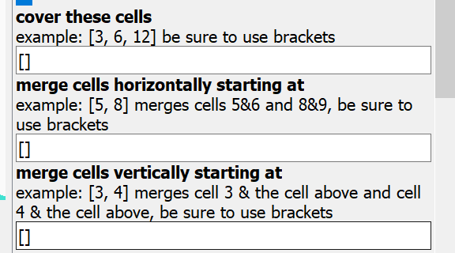
Advanced Grid-Based Concepts (Merging and covering cells in the grid)
Live Demo…
If you make a mistake, put a zero between the brackets: [0]
This is an OpenSCAD bug – just my opinion…
Notes:
Let’s see this in action…
[bring up OpenSCAD]
Note, if you change your mind entirely, you have to put a 0 in between the brackets, just deleting what you typed in won’t work.

Slide 58
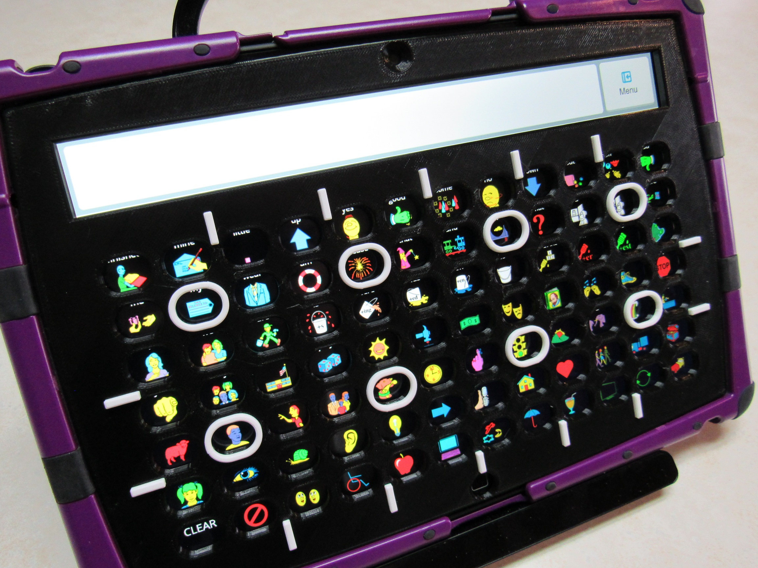
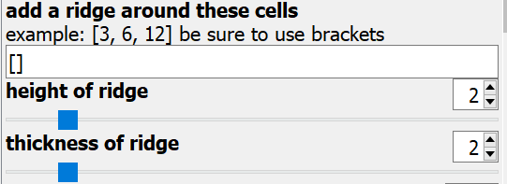
Advanced Grid-Based Concepts (Putting ridges around cells: LWFL - VI)
Note: small lines are horizontal and vertical ridges included in the case_openings.info file.
Contrasting colors are achieved by swapping filament colors during the print.
Live Demo…
Notes:
One of the significant advantages of 3D-printing over laser-cutting is that your keyguard can have raised elements. These raised landmarks can be critical for visually impaired and blind individuals. This picture is a 3D-printed version of the keyguard for Lamp Words for Life – VI.
There are three options in the Grid section of the Customizer to add ridges around specific cells
Note that the raised lines around the outside of the grid are the result of instructions added to the case_openings.info file
The ridges are white because the color of the filament was changed part-way through the print
Let’s see what this feature looks like in action…
[bring up OpenSCAD]

Slide 59
Advanced Grid-Based Concepts (Handling tight-fitting cases)
Cases with keyguards often leave very little space between the edge of the screen and the case opening. That means that the keyguard will have a very thin perimeter an be very fragile.
Some AAC apps help by resizing the layout to make more room for the keyguard.
If that’s not enough, or not possible, you can thicken the perimeter but it will eat into the space around the outermost openings.
Notes:
The case is critical to your keyguard design – in particular, the case opening.
If the case opening wraps the screen tightly, the keyguard perimeter will naturally be thin and the keyguard will be fragile.
The AAC app may be able to help by changing the layout or size of the buttons to make more room.
But if not, or if you need even more room, the designer can help – but you can’t get something without giving something (in this instance, space)

Slide 60
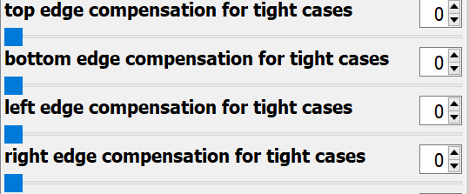
Advanced Grid-Based Concepts (dealing with Screen Protectors)
You have control for each outer edge of the keyguard
These values are in the Special Actions and Settings section.
Live Demo…
Notes:
This problem of a very tight case opening is almost always associated with the use of a screen protector.
You can add more plastic to each edge side of your keyguard. However, note that there’s no way to do this without loosing the same amount of access to the screen.
You’ll find these four options in the “Special Actions and Settings” section of the Customizer.
Let’s see them in action…
[bring up OpenSCAD]

Slide 61
Advanced Grid-Based Concepts (Splitting a keyguard that is too Large to Print)
3D-printers with print beds larger than 300 mm are VERY expensive.
While laser-cut keyguards have lots of limitations, they can be cut from very large sheets of acrylic.
With the keyguard designer can split your keyguard in half. You’ll display, render and save one half of the keyguard at a time.
Select each half in the “generate” pull-down list of the Special Actions and Settings section.
Live Demo…
Notes:
What if you’re keyguard needs to be 315 mm wide but your 3D-printer can’t print anything wider than 300 mm?
There are very large 3D-printers, but they are very expensive.
A laser-cut keyguard has limitations and it will cost you more, but it might be your best choice because they can be cut from very large sheets of acrylic.
The designer will support you in splitting your keyguard into two halves and printing one half at a time.
The options to control this feature all located in the “Special Actions and Settings” section of the Customizer
Let’s see these options in action…
[bring up OpenSCAD]

Slide 62
Advanced Grid-Based Concepts (Managing multiple keyguard Designs)
You’ve put a lot of work into a keyguard design and, after several months, you need to make a change, or you need to make another.
You absolutely don’t want to start from scratch.
So, save your work in a way that makes it easy to recreate your design
The web page above is pretty comprehensive.
Notes:
The work you’ve done to create each keyguard is valuable.
It can give you a leg up when you need to create your next keyguard, or you may need to replace a keyguard that has been lost or broken.
When you have a keyguard that fits the case and app really well, the last thing you want to do is start over from scratch.
You can save all your work and then quickly recreate your previous keyguard at a later time.
The link in the title of this slide is pretty complete in describing what you need to save and how best to save it, so I’ll just suggest that you review that page. But we’ll take a shot at organizing our work from this workshop…

Slide 63
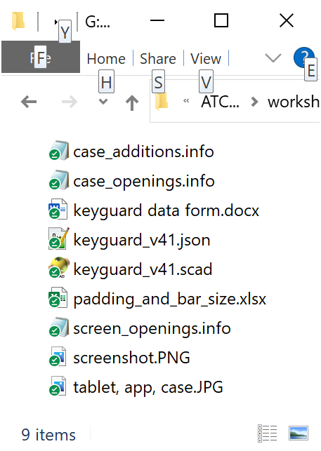
Designing our keyguard from scratch (Organizing your work)
We’ll create a folder for this keyguard containing:
photos of tablet, case, and running app
screenshot and SVG of screenshot (described later)
any modified info files
padding and bar size spreadsheet
data form – especially, if provided by someone else
STL file generated by the keyguard designer
Create a preset to save the values of the Customizer options (creates .json file)
Notes:
Let’s look at the items that we’ve used in creating our example keyguard
Step 1 is to create a folder and we’ll put all files specific to this keyguard in that folder:
photos of the tablet in the case while the app is running in its targeted layout
the screen shot and the SVG file that you created from that screenshot
if you’ve added instructions to any info files, put them in the folder (you should keep a clean version of info files somewhere separate, so you don’t have to constantly download new ones from Thingiverse.
the measurements spreadsheet – which is another file to maintain in pristine form elsewhere
the filled-in data form – especially important if it was filled out by someone you’re working with (and another document to keep on hand in clean form)
and the STL file that you printed – as a way to shortcut the process when you need one more of the same keyguard
When you add your first preset, OpenSCAD will create a companion file that ends in .json. Each additional preset will also go in this file. Backup this file regularly. If you download a new version of the keyguard designer, just change the name of the .json file so that the version numbers match.
Note that you can keep the keyguard.scad and .json files separate from the folder where you keep your keyguard-specific files. You don’t need a copy for each of your keyguards.

Slide 64
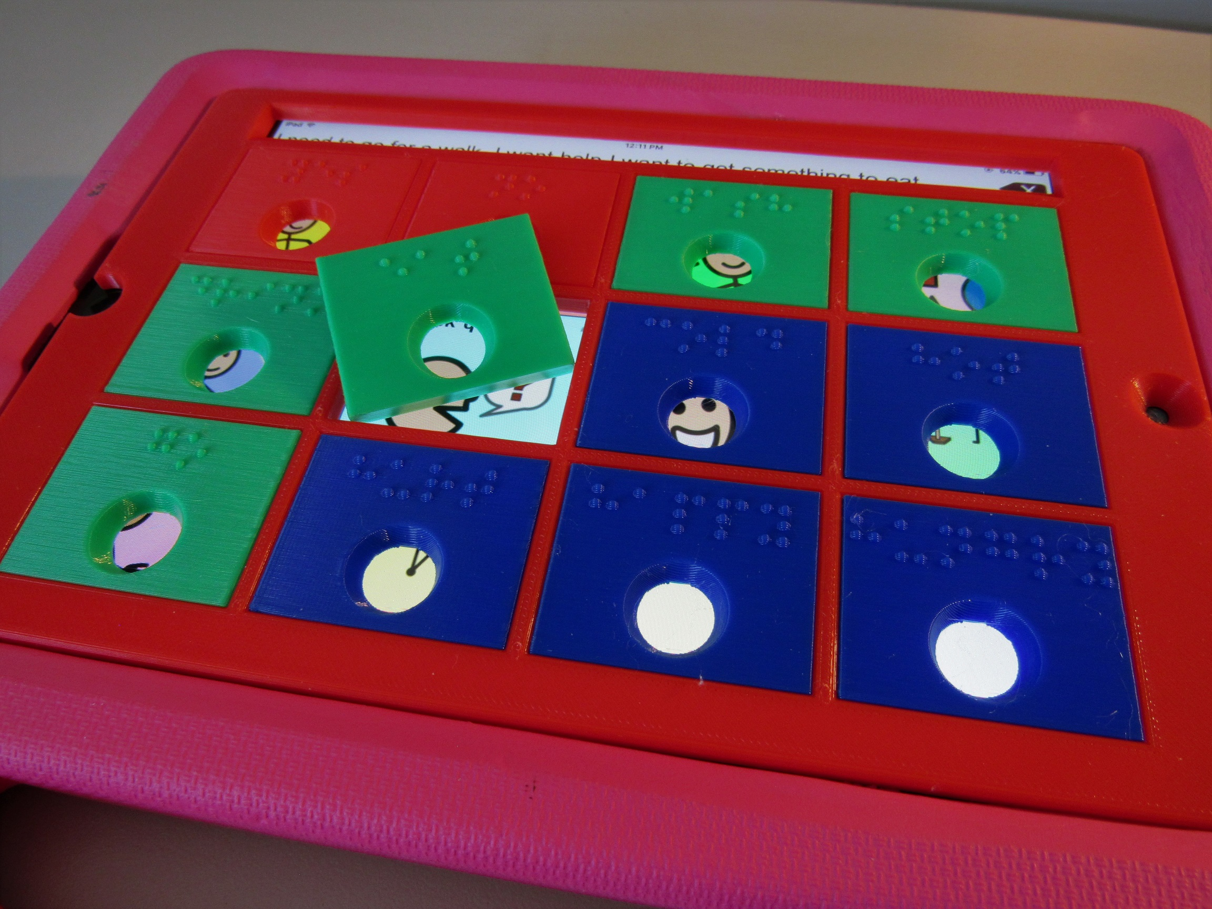
Advanced Grid-Based Concepts (Creating Braille inserts)
How can you give Braille-capable individuals a voice?
How can you leverage a custom keyguard to serve as a framework?
How can you easily add Braille to your AAC app?
Notes:
AAC apps on tablets are fundamentally designed to be used by sighted individuals.
Is there a way to use a keyguard to make the app accessible to someone who’s blind or visually impaired?
Since you’ve learned how to create a keyguard for your app, can you use it to help these folks select the right app button?
The designer supports creating Braille inserts that squeeze into the openings in the grid…

Slide 65
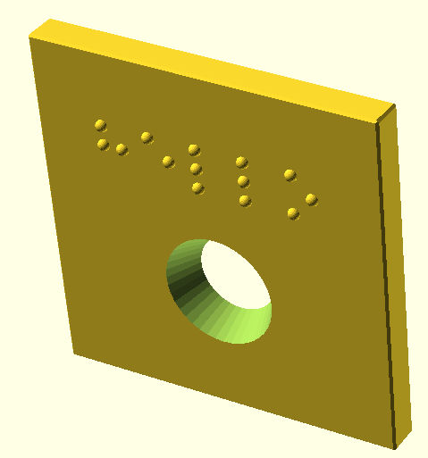
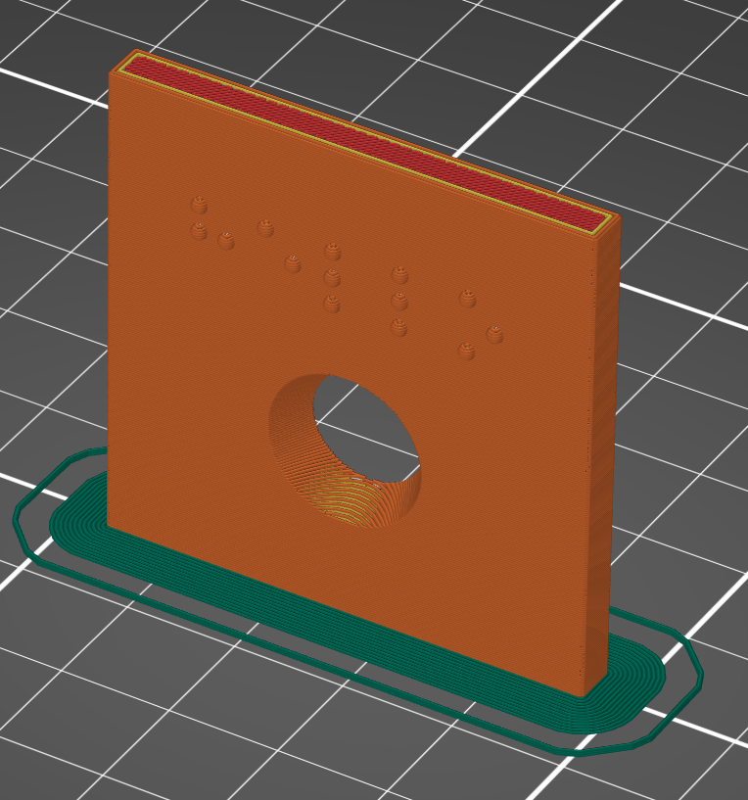
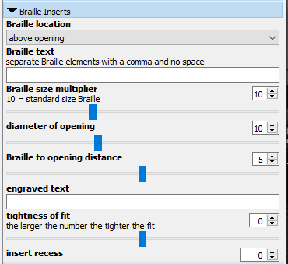
Advanced Grid-Based Concepts (Braille inserts Demo)
Print these inserts on their edge, like the orientation in the designer. This will produce the best Braille. You may need to add a “brim” to your print.
Notes:
The options for creating the Braille inserts are in the Braille Inserts section of the Customizer. You also need to ensure that your keyguard has rectangular openings and 90-degree rail slopes.
Let’s look at these options…
[demo in OpenSCAD]
Note that the designer will display your insert on its side. That’s how it should be printed as well so that the Braille comes out as smooth and readable as possible.

Slide 66
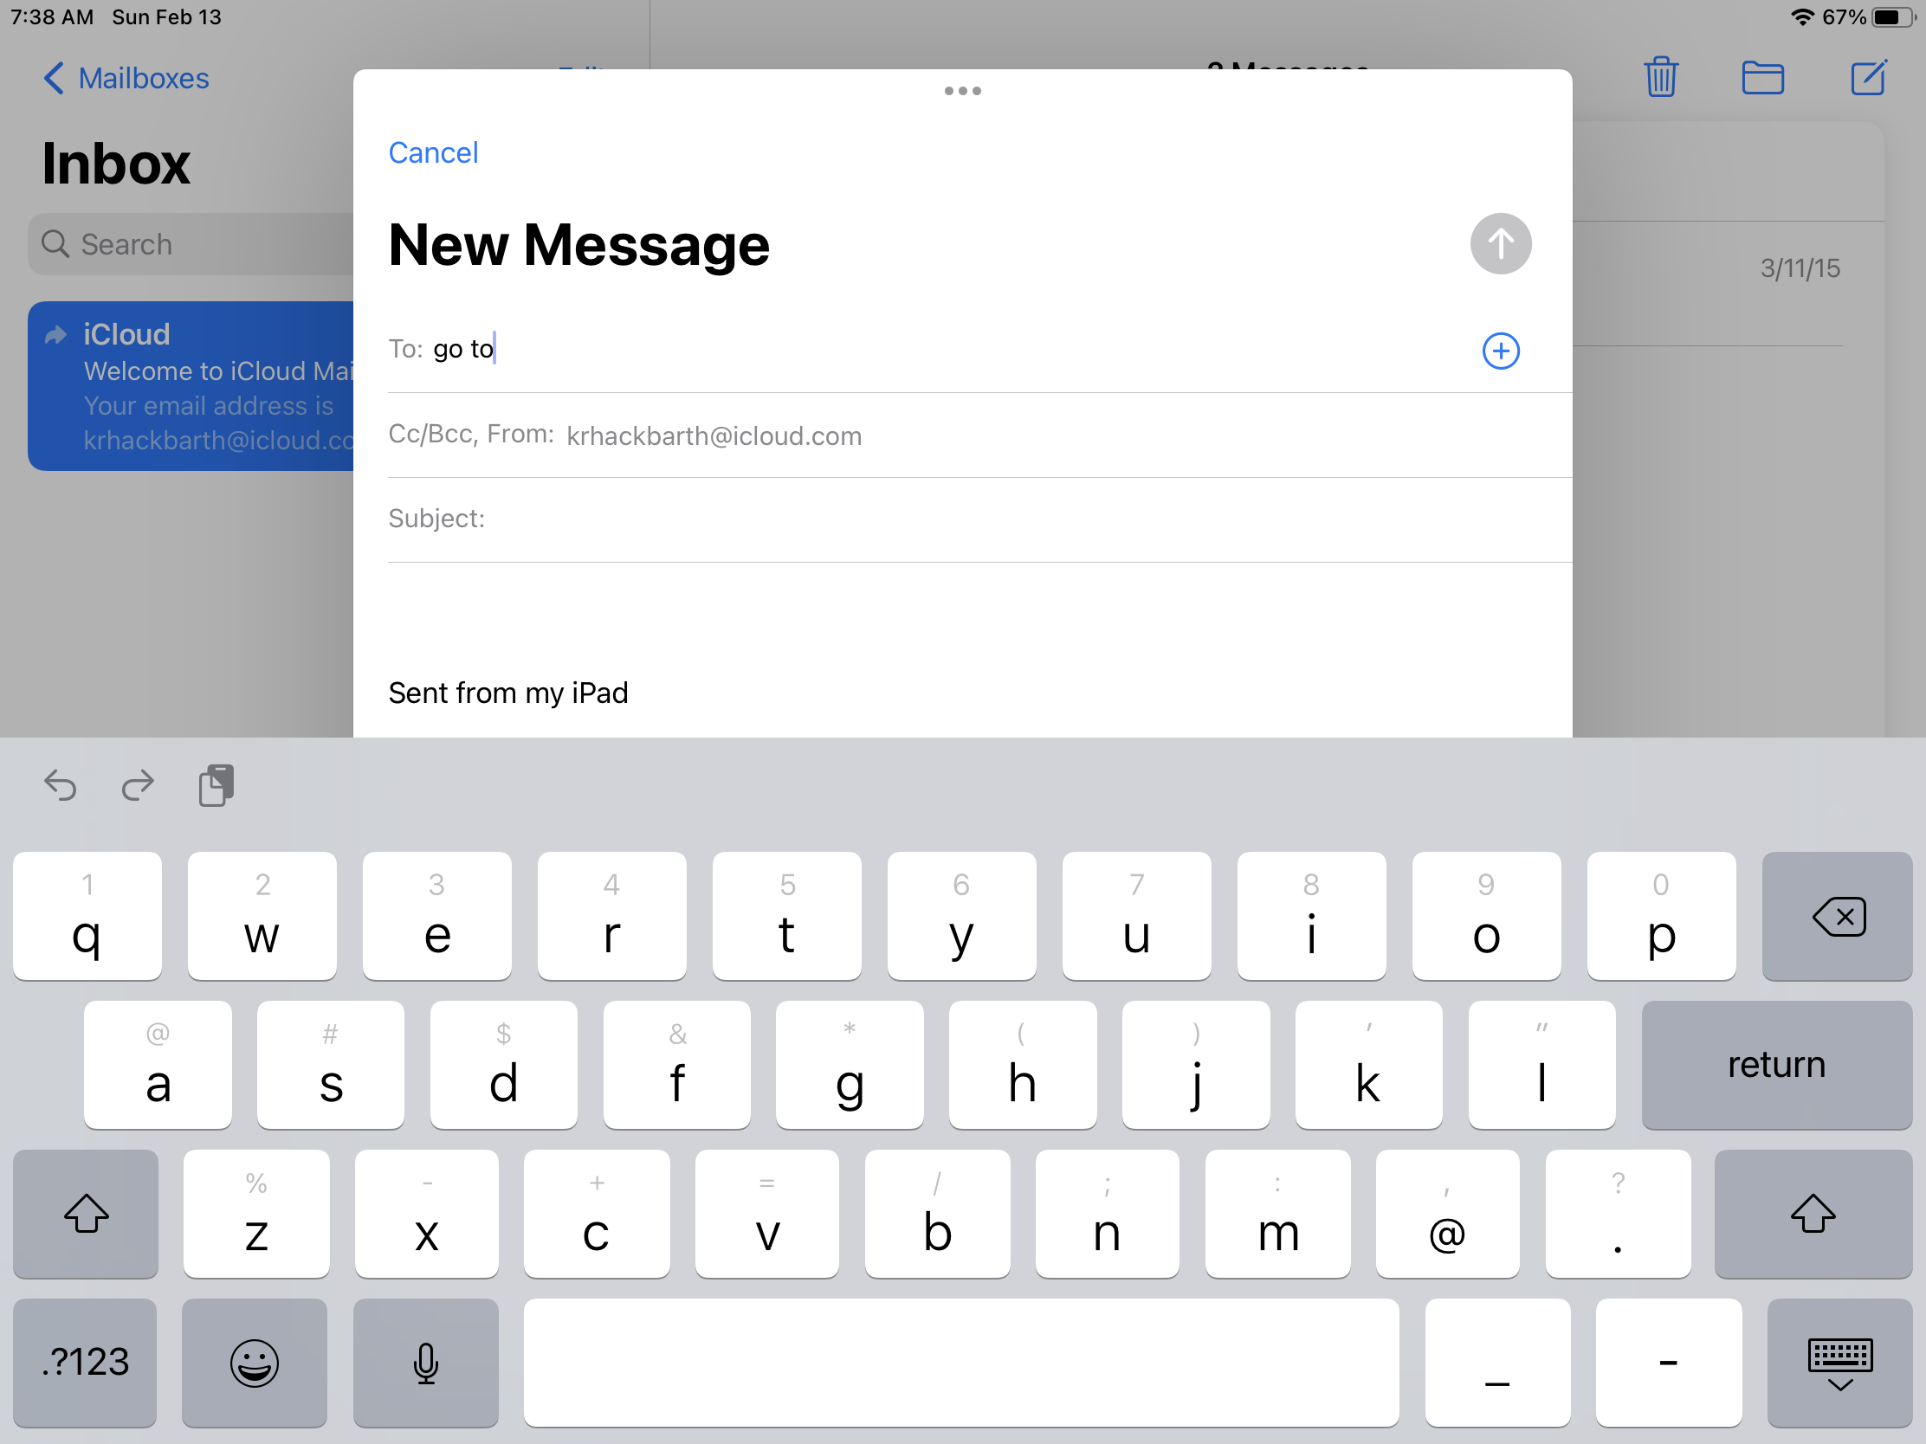
Free-Form Keyguards (not a simple grid)
openings that are not arranged directly above and below each other
openings of different sizes and shapes
set columns and/or rows to 0 to start…
Notes:
Time to leave the grid-based and hybrid keyguards behind and talk about free-form keyguards… Fundamentally, a free-form keyguard doesn’t have a simple grid of openings.
That means that openings aren’t located directly above and below each other.
In addition, openings may be of different sizes or shapes
Start your design by setting the number of rows or columns to zero – like we did before putting the engraved text on our keyguard. That will give you a solid piece of plastic to put your openings in.

Slide 67
A free-form keyguard is just a collection of openings
Look for patterns to save time:
all keys are rounded rectangles
key heights are all the same
many keys have the same width
y values are shared for several keys
Keep a written record for corrections
get help from a friend (one person measures while the other person records the measurements)
screen_openings.info is the key player
Live Demo…
y₁
y₂
y₃
Notes:
You are going to specify every opening (other than Home button and camera) in the keyguard. Note that for an entirely new type of tablet, you may need to specify the openings for the Home button and camera as well. Also note that every keyguard “could” be modeled as a free-form keyguard but that would be a lot more work than necessary.
To save yourself some time, look for patterns:
do all the openings have the same shape?
though they may not all have the same width, do many or all openings have the same height?
which openings do have the same width?
do a set of openings all have the same y value? ? ?
It really helps to keep a written record of your measurements (we’ll use a spreadsheet to make calculations easier)
and it’s easier if one person measures while another person records the measurements.
We’re going to do all our work in screen_openings.info
Let’s try designing a keyguard for an email composition window…
[go to freeform keyguard folder]

Slide 68
Laser-cut your design
Sometimes a laser-cut acrylic is the right answer for your keyguard
you need a transparent keyguard
you need a large, single-piece keyguard
you need a strong keyguard
raised elements and angled cuts aren’t critical
Does your STEM class have a laser-cutter?
KeyguardAT has a special offer that could save you lots of money
You do the design work; they cut (or print) your keyguard for $40*
First, 3D-print your design as a test
Quick Demo…
Notes:
When is a laser-cut acrylic keyguard the right answer for you?
if you need a transparent keyguard, you can’t get one with a 3D-printer – the best you can get is translucent
if you need a large, strong keyguard then it needs to be a single piece (not split in half and glued)
even with a smaller keyguard, if you need a keyguard that can take a beating, acrylic is a good choice
of course, you will need to do without any raised features because every acrylic sheet is flat – and corners will be sharp because a laser cuts directly down from above, you can’t angle them.
If your STEM class has a laser-cutter, you may be able to give them a reason to finally use it!
If not, Keyguard AT has a great offer.
They’ll cut the keyguard for you if you give them a design – and our keyguard designer will support you in producing that design.
If you can, 3D print at least the first few layers of your design before you send it to Keyguard AT so you’ll be confident that the keyguard you receive from them will fit.
Let’s see how easy it is to design a keyguard to be laser-cut…
[bring up OpenSCAD]

Slide 69
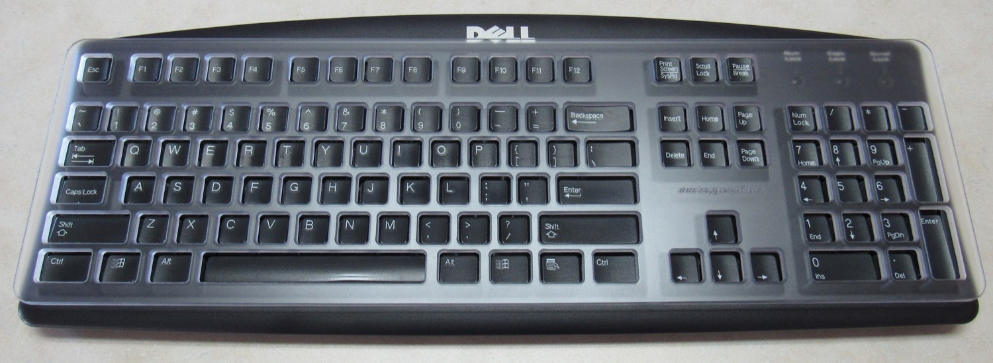
A “really big” free-form keyguard
A standard PC keyboard is huge when compared to any tablet
But you can still use our keyguard designer (tablet = blank, case = yes)
Laser-cut is the only option that makes sense – we used the KeyguardAT offer
Show & Tell…
Notes:
Here’s an example of a really big keyguard that simply could not be 3D-printed.
I used the keyguard designer to design it referencing a specialized tablet called “blank”, I put all the instructions in case_openings.info so I have to pretend that it has a case, and the lower left corner of the lower left key is treated as the 0,0 coordinate of the case opening. All measurements are in millimeters.
We used the Keyguard AT offer to print the keyguard (nice that the price doesn’t increase even though this is a very large keyguard). – we also 3D-printed the first few layers several times to ensure a nice fit before submitting our order.
Let’s take a look…
[show keyguard and test layout]

Slide 70
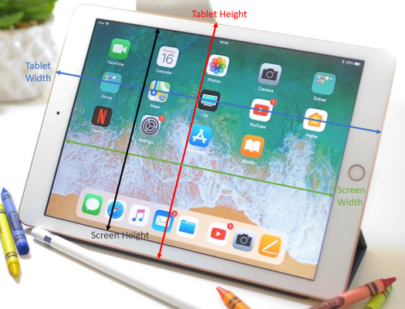
Bonus Content (Adding New Tablets)
Notes:
The first version of the keyguard designer supported 15 iPad models and that’s all. Forty versions later, it now supports 27 different iPads and 27 non-iPad tablets. Many of those new tablets were added with the help of SLPs from across the country and around the world.
It is relatively simple to add support for a new tablet to the designer. It requires about 12 measurements and a good screenshot. I’m happy to work with you to add your tablet to the designer or you can do it yourself by following the instructions on the web page linked in the title of this slide.

Slide 71
Bonus Content (keyguards for Chromebooks)
Chromebooks have a standard set of keys and a standard layout
Chromebooks are thin - the keys sit in a well
space is tight and mounting methods are limited
The Chromebook screen lays against the keys when closed
so the height of the keyguard is limited
presents a problem for hard keyguards – especially laser-cut keyguards
Show and Tell…
Notes:
This keyguard designer cannot design a keyguard for a Chromebook – that’s why we created a separate designer just for this purpose. The link at the top of the slide will take you there.
The thing that makes the process of designing a Chromebook keyguard reasonable is that all Chromebooks share a standard set of keys in a standard layout.
Chromebooks put all their keys in a small well so that the screen can close over the keyboard – that also means that we have to be creative in how we mount the keyguard.
The keyguard can’t be much thicker than the height of a key. This can be a big problem for laser-cut keyguards which come in just a few thicknesses.
Let’s look at an example…
[show Chromebook and two types of keyguards in “live” cam]

Slide 72
Bonus Content (keyguards for iPad keyboards)
iPad keyboards very significantly in shape and size
Key number and layout varies but it must be “touch-typeable” so there’s some consistency (i.e., “QWERTY)
Mounting the keyguard securely can be a challenge
Show and Tell…
Notes:
Same story when creating a keyguard for an iPad keyboard – it had to be a separate designer and the link in the title will take you there.
Unlike Chromebook keyboards, iPad keyboards vary quite a bit in their shape, size, and layout.
Fortunately, they are designed to be “typeable” so they have a standard “QWERTY”-style layout for the alphabetic keys.
These keyboards try to have as small a form-factor as possible so it can be difficult to find space to mount the keyguard.
Let’s look at a couple of those….
[ show iPad keyboards and keyguards in the “live” cam]

Slide 73
Finished keyguard!
Notes:
Let’s take a look at the keyguard that should have stopped printing by now and see how it fits.
[printer cam and then live cam]

Slide 74
Questions (post your questions in the chat, I’ll unmute for follow-up questions)
?
Send other questions to ken@volksswitch.org
Notes:
Time for some final questions.
Please continue to post your questions in the chat window. I’m going to unmute everyone so we can get further clarification if necessary.
…
If you don’t want to ask your question now or if questions should come to you after the workshop ends, please feel free to send me your questions at my email address.

Slide 75
Easy Measurement tool offer
If you plan create 3D-printed keyguards, email your postal address to me (ken@volksswitch.org) and I’ll send you a free EMT.
Notes:
As the slide says, if you plan to design some keyguards – and I assume you are or you wouldn’t have signed up and sat through a 3-hour workshop – send me your postal address and I’ll send you an Easy Measurement Tool for free.
Again, if you didn’t sign up for the workshop and are instead watching the recording, consider making a donation to the conference using the email address I included on the second slide.
That’s all I have – thanks for listening.

